Slide 1
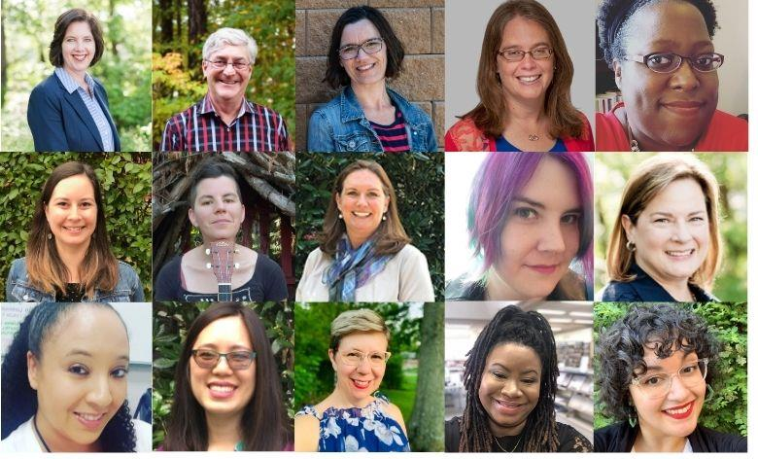

Welcome
To Other Duties as Assigned: A Day of Learning
#NoveListDayofLearning

Slide 2
Table of Contents
#NoveListDayofLearning
RA Evolution: Going to Where we Have Been Before
RA Basics Renovated: Flip Your Focus and Think Like A Reader
Islands in the Stream: Navigating the Waters of Collection Development
Digital Storytelling: Moving Your Storytime Online
Surprise! Contactless Browsing to Keep Readers Coming Back
Email Newsletters: Easy as 1-2-3
#Library: Digital Readers' Advisory

Slide 3


RA Evolution:
Going to Where we Have Been Before
Presenters
Duncan Smith
Chief Strategist, Public Libraries
Co-Founder of NoveList

Slide 4


Reader’s Advisory Evolution:
Going to Where We Have Been Before
Duncan Smith, Co-Founder NoveList
Chief Strategist, Public Libraries

Slide 5



A Reading Ecology: Relationships
Readers
Books
Staff

Slide 6



A Reading Ecology
Discover
Discern
Deliver
Notes:
Anyone who is seeking a reading experience has to go through three stages: learn about items they want to experience (discover); figure out if this is right for me (discernment) and final they have to get it (delivery). In the past, my reading ecology might be something like this: a friend tells me about a SF book I might like “A Memory Called Empire” because Ann Leckie (whose Ancillary Books I was over the moon about) wrote a blurb raving about it– it also won the Hugo (Discovery). I hop over to Topeka’s catalog to see if it owned– it is AND it is available on the shelf and via download. I just the reviews (both published and reader) notice that the recommendations on the side include Ancillary Justice– I’m all in. Who says real life doesn’t have happy endings.

Slide 7

Library Value in the Ecosystem: Yesterday
Discovery
Discernment
Delivery

Slide 8


Library Value in the Ecosystem: Today & Tomorrow
Discovery
Discernment
Delivery

Slide 9



A Reading Ecology: Adding Value Today & Tomorrow
Discover
Discern
Deliver
Deepen
Notes:
In addition to Discovery, Discernment, Delivery--- the disruptions caused by COVID 19 have positioned Topeka to evolve reader services from readers’ advisory to reader engagement by deepening your relationships with your readers.

Slide 10

A Brief History of Readers’ Advisory
1920s
  Jennie M. Flexner—NYPL
  Reading plans focused on learning
  Ongoing relationships with readers

Slide 11
Readers’ Advisory Renaissance
Joyce Saricks & Nancy Brown develop concept of appeal
Readers’ Advisory Service in the Public Library published
1982
1984
1994
1983
1989
Betty Rosenberg
publishes Genreflecting
Adult Reading Roundtable
(ARRT) formed in Chicago area
First copy of NoveList
sold to Joyce Saricks at Downers’ Grove Public Library in Illinois
(came with its own computer!)

Slide 12

Moving up the Reader Engagement Ladder
1
Introduce reader to new authors and titles.
Increase reader ability to understand what they like.
Expand reader strategies for finding more.
Deepen their appreciation of reading.
Support reader in sharing their reading with others.
2
3
4
5

Slide 13
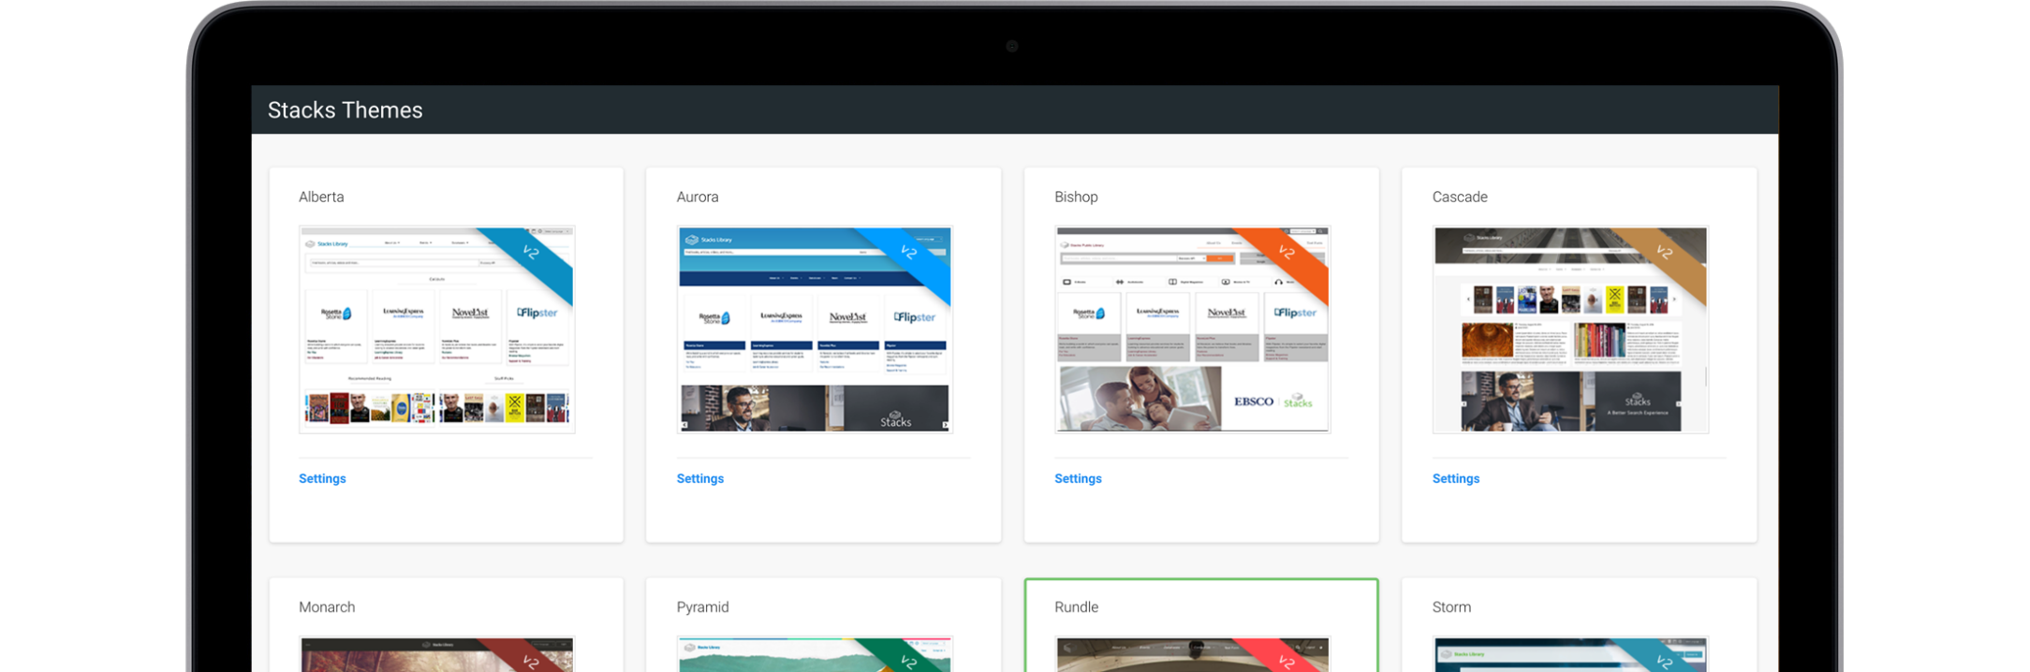
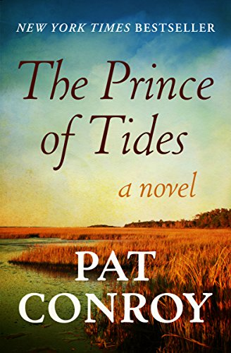
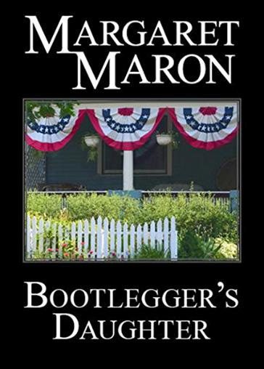
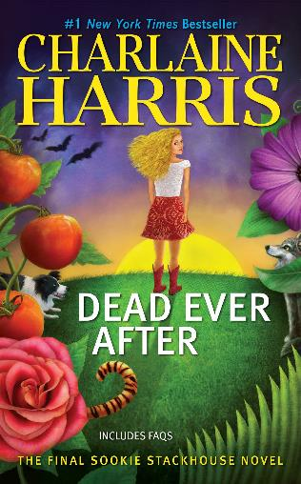
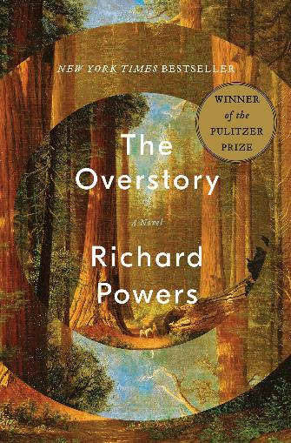
Titles for Joanne

Slide 14

Autumn suggests There, There to Joanne
I chose this based on some of the things you mentioned in your book talks
You also mentioned that you enjoy reading about racial injustice
You like a story rich in characters
You also talked about enjoying books with humor – while this book tackles difficult themes, the author adds humor to this power book
Notes:
The story focuses on 12 Urban Indians (native peoples) living in Oakland, California. Their stories will collide one fateful day at the Big Oakland Powwow. I chose this based on your some of the things you mentioned in your book talks. You like a story rich in characters - There, There There follows 12 characters. You also mentioned that you enjoy reading about racial injustice or the racial divide - There, There discusses the trials and tribulations of native people living in an urban setting. You also talked about enjoying books with humor - while this book tackles difficult themes, the author adds humor to this power book.

Slide 15


Joanne’s Response:
Yes, this looks like a book I’d enjoy. The evaluation of why I would is good.
I’m adding it to my list! Am happy to say the library as the ebook!

Slide 16
1
In her short reply, Joanne indicates that she thinks she might like the book.
She was motivated enough to take action to obtain the title by checking to see if the library owned it.
She put it on hold.
Introduce reader to new authors and titles.
Notes:
Autumn introduced Joanne to a new author and title. In her short reply, Joanne indicates that she thinks she might like the book. She indicates that she is adding it to her list (which I am assuming is her holds list). She was motivated enough to take action to obtain the title by checking to see if the library owned it.

Slide 17
2
RA is the art of introducing unknown items to a reader and connecting that item to identified reader interests.
Autumn focuses on elements that the reader has stated as preferences. Then explicitly restates the reader’s preference allowing the reader to make the connection.
This approach increases the likelihood that the reader will consider the title. Joanne’s response to Autumn’s description also indicates that this reader feels heard!
Increase reader understanding about what they like and why.
Notes:
RA is the art of introducing unknown items to a reader and connecting that item to identified reader interests Autumn’s description of the title focuses on elements that the reader has stated as preferences. Autumn then explicitly restates the reader’s preference allowing the reader to make the connection.
This approach increases the likelihood that the reader will consider the title. Joanne’s response to Autumn’s description also indicates that this reader feels heard!

Slide 18
3
We might respond to Joanne’s email reaction with something like this:
If you are interested in reading about different cultures or diversity issues, we have a resource that identifies authors by their nationality and ethnic origin. It also can be used to search on topics like racial justice, etc. I would be happy to send you a link to this resource or set up an online meeting where I can show it to you.
Expand the reader’s strategies for finding more of what they like.
Notes:
We might respond to Joanne’s email reaction with something like this:
If you are interested in reading about different cultures or diversity issues, we have a resource that identifies authors by their nationality and ethnic origin. It also can be used to search on topics like racial justice, etc. I would be happy to send you a link to this resource or set up an online meeting where I can show it to you.

Slide 19
4
Consider evocative questions that invite the reader to explore their reading experiences.
Racial justice is a popular reading interest right now. Are you willing to share a book on this topic that provided new understandings or insights for you on this topic?
This question might lead the reader to talk about:
The Queen of Palmyra.
Deepen their appreciation of reading.
Notes:
This goal is not necessary for every RA conversation and Joanne is clearly a reader who understands her likes and dislikes. This deep insight into her reading life is something that we want to develop in all readers.
Autumn has already achieved a lot in this email exchange with Joanne. If we wanted to work this goal, we could ask Joanne if she is willing to share what she has “learned” about racial justice or the racial divide from her reading. NOTE: This book isn’t owned by Topeka but based on this discussion the library might consider purchasing it.

Slide 20
5
Ask the reader if they would be willing to join a book discussion of this title or attend a virtual “author talk” by this author.
Encourage the reader to review the “list” of titles dealing with racial justice to encourage her to share her thinking.
Support readers in sharing their reading with others.
Notes:
Support readers in sharing their reading with others.
In this classroom situation, Autumn viewed several videos of this reader talking about a book they read and enjoyed. If this were a form-based interaction or even a chat conversation, the reader would have probably written more about the authors and titles that interest them.
If the reader presents descriptions that are insightful and interesting, she could be encouraged to post-them to Bibliocommons, for example, or shared via other digital means in our current environment.
Another option is to ask Joanne to review a booklist created in Bibliocommons or created by the library on a topic related to her reading and get her reaction.

Slide 21


What Reader Problem Do I Want to Solve?
I would like to help older adults find what they want to read. I want to have a readers conversation and dig in, narrow down what they are actually looking for in that next book.
Most of the time a patron can tell you an author they like, but not necessarily why they liked it.

Slide 22

Reader Conversations
Call older adult homebound patrons like normal.
Change the questions being asked.
  Instead of "What kind of books would you like me to bring?" Or, "What author would you like to read?“
  Start with, "Out of the books I pulled for you last time, which one stood out?“
  What was the last books you really enjoyed?

Slide 23
Further Reader Conversations
In further conversations expand the questions being asked to include past reading experiences
What is the first book you remember reading?
Was there one person who was a big influence on your reading habits?
Do you reread books? If so which ones?
What book genre's do you love?
Do you ever read a book based solely on its cover?
Are there any book dealbreakers for you?

Slide 24


I have been taking her books for 14 years.
Learning new things. Like she does reread books, but only non-fiction.
Got her thinking about her parents and their influence on her reading habits.

Slide 25
Reader Engagement Goals: Measurement
1
Introduce reader to new authors and titles.
  Sample measure: Did you learn about new titles/authors as a result…
Increase reader ability to understand what they like.
  Sample measure: Did you learn something about the type of books you like as a result…
Expand reader strategies for finding more.
  Sample measure: Will you look for your next book differently as a result…
Deepen their appreciation of reading.
  Sample Measure: How do you feel about reading as a result…..
Support reader in sharing their reading with others.
  Sample Measure: Will you talk/share with anyone about this/these books or your insights about reading?
2
3
4
5

Slide 26

Moving up the Reader Engagement Ladder:
“Remember that today’s problems come from yesterday’s solutions .”
Peter Senge
The Fifth Discipline: The Art and Practice of the Learning Organization

Slide 27


Thank you and keep up the great work!

Slide 28
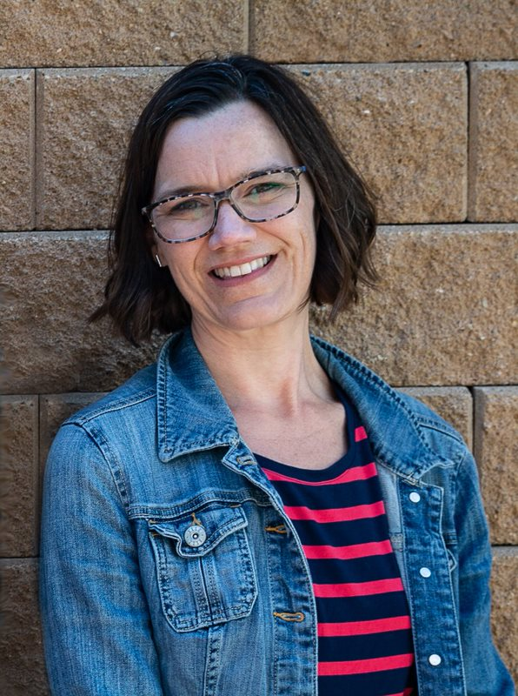
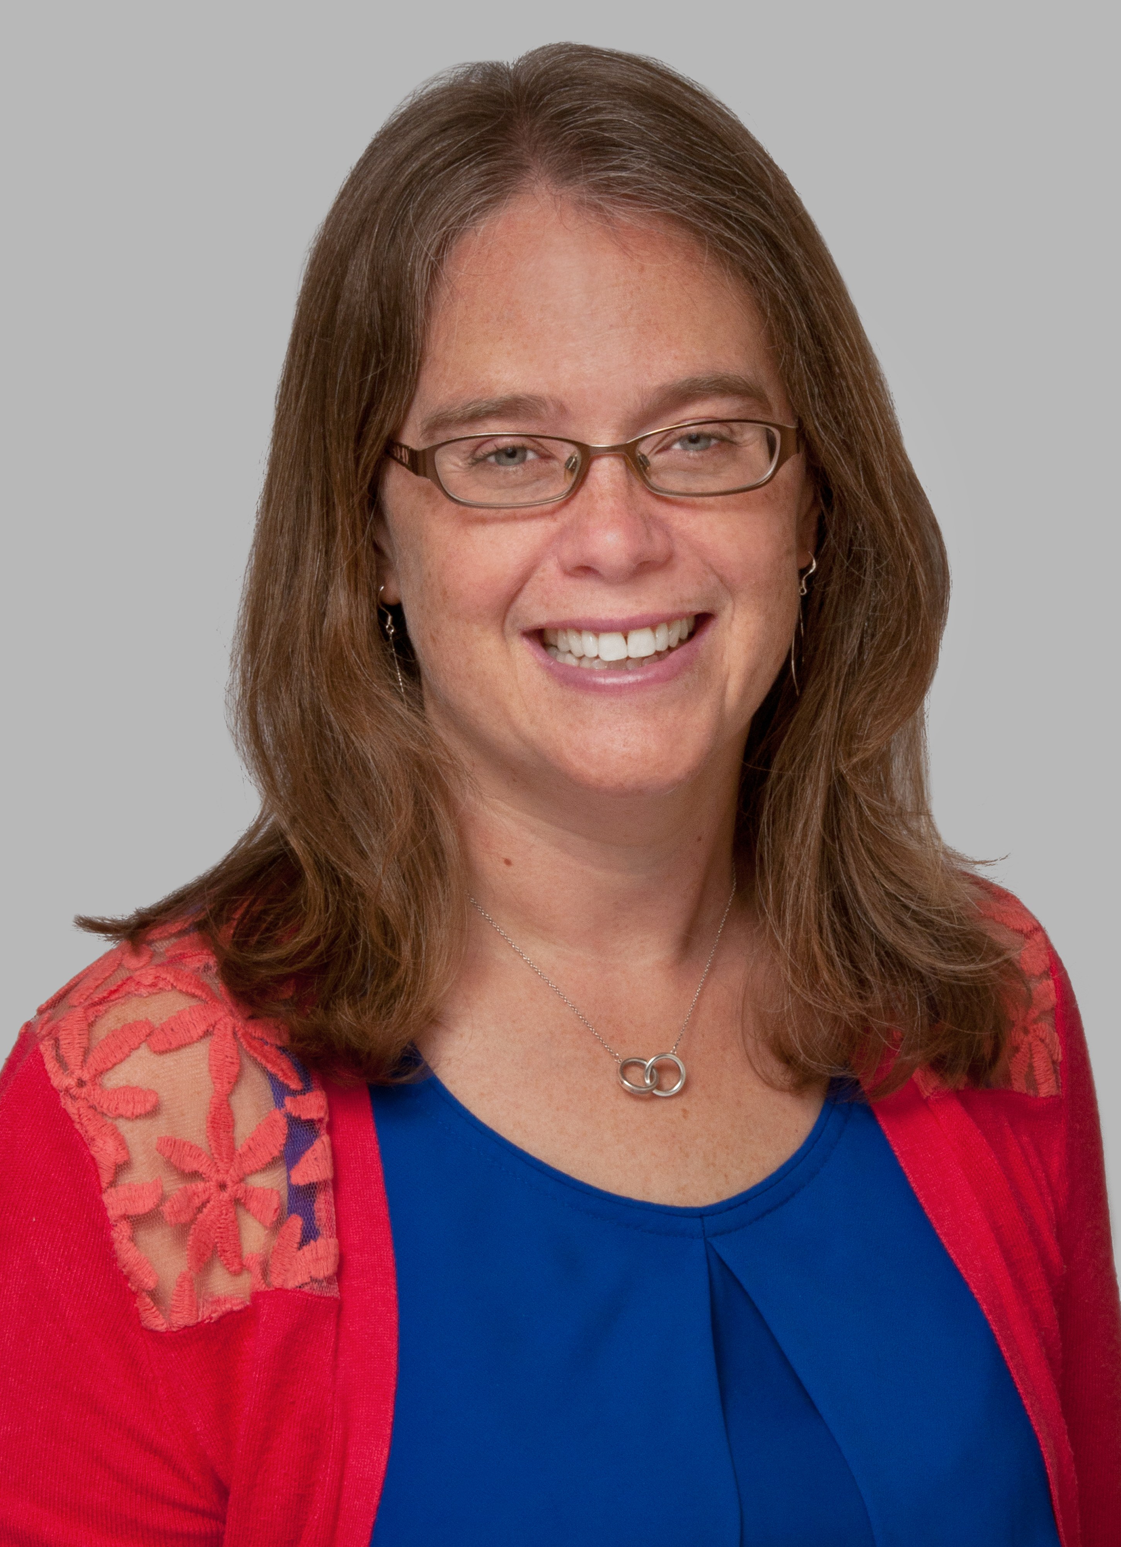


RA Basics Renovated
Flip Your Focus and Think Like A Reader
Presenters
Autumn Friedli
Becky Spratford
Readers Services Supervisor
Readers’ Advisory Specialist

Slide 29
Flip Your Focus and
Think Like A Reader:
RA Basics Renovated
Becky Spratford, RA Specialist, RA for All
Autumn Friedli, Readers Services, TSCPL
Presented for NoveList Day of Learning
February 10, 2021
#NoveListDayofLearning

Slide 30
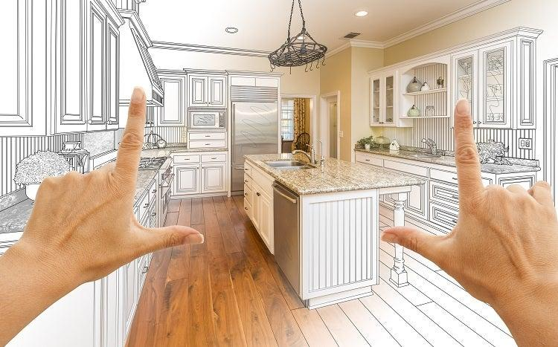
Conversations vs Transactions
Evolution of RA service
Shift in emphasis means...time to renovate!
4 easy to replicate segments
  Or renovate our ideas and turn them into your own
RA Service is 60% Listening, 40% Action
Notes:
Becky’s quick intro to how RA has evolved and the renovations we suggest.
Not that different than library or home renovation. Spaces need refreshing,we know this. After too many visitors library spaces are shabby. Our services also need renovations over time. Renovations need planning and thought, things will not all go smoothly, but in the end, you will be refreshed and happy.
Explain change and how we will handle it.
Picture citation: https://www.entrepreneur.com/article/297458

Slide 31

Sharing Anything (whether you read it or not)
Somebody HAS read it, just not you
Be honest - “I haven’t read this, but my friend Chris loved it.”
Notes:
Autumn
Image url: https://www.mystgalaxy.com/sites/mystgalaxy.com/files/Books_are_better_shared.png

Slide 32
Sharing Examples
Create a culture of sharing books in your library.
Podcasts...shameless plug TSCPL’s The Bookmark
Webinars
Blogs
Goodreads
NOVELIST! The reason we are here today!
Be creative and look for other resources.
Notes:
Autumn

Slide 33

Conversation Starters
Creating relationships NOT tallying transactions
Dialog NOT monologue
Talking about books, book news NOT making a match
Why NOT what
Listen and learn
Notes:
Becky
Image url: https://media.npr.org/assets/img/2011/12/06/book-club-0d05cde6ad5a1a3c0fa7dcb9d8f7289cabb6bf54-s800-c85.gif

Slide 34
Conversation Starters Examples
In person-- have fun “why” questions:
  What’s your least fav book? What’s your fav to recommend? Where do you get book recommendations for yourself? What was the most fun you had reading a book in the last year?
Socially Distant: Curbside Passive RA
Online-- Unboxing Videos
Both-- interactive displays
Both-- use props
  Grab an item in person or post it online and share why you picked it
Notes:
Becky

Slide 35

The Art of the Handoff
Could be a book, a resource...or both.
The HOW is just as important as the WHAT.
Think RELATIONSHIP not TRANSACTION.
Notes:
Autumn
Note from Becky-- I like this relay race analogy from the image. It is a two way street [conversations] and how we “handoff”is vital to success, but nix it if you want and add a different picture.
This image is PERFECT. This is where relay races are won or lost.
Image url: https://femgineer.com/wp-content/uploads/2013/11/handoff.jpg

Slide 36
Handoff Examples
Explain the why and use their words
  Prove you heard them
Connect them to more
  Don’t be a Pushy Salesperson
Encourage feedback
  Think “Reading Relationship”

Slide 37

Inspiring All Staff To Help
Working together is your best resource.
Real talk...You will never know all the books!
All staff can be part of core service.
The more staff included, the more diverse your pool of suggestions.
Notes:
Becky
Added bonus-- more diversity. Both in who is helping-- our staff are more diverse than the professionals, and more voices, more options-- children’s librairan who loves erotica
Image url: https://www.ottawalife.com/admin/cms/images/small/hand-1917895_1920.png

Slide 38
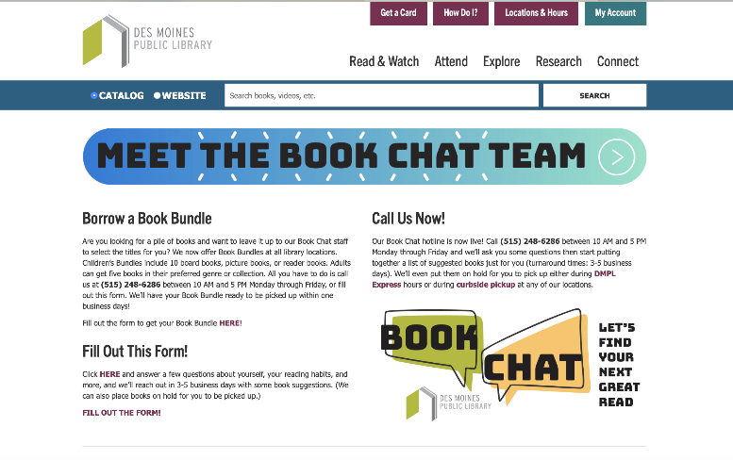
Working Together Examples
Don’t wait for volunteers
  invite participation
Goodreads Shelves
Stock Your RA Pantry
Did you listen to patrons?
  Use what they have shared.
Covid Success Story:
  Des Moines Public Library
  Their Goodreads
Notes:
Becky

Slide 39
Final Thoughts
6 Ways Anyone Can RA, Regardless of Job Title
  Article in NoveList by Becky
No correct way to do this, but guiding principles to renovate your thinking.
Share, Converse, Handoff, Work Together
  Make it fit your strengths, staff, and patrons
RA Service is 60% Listening, 40% Action
Notes:
Autumn-- summarize

Slide 40
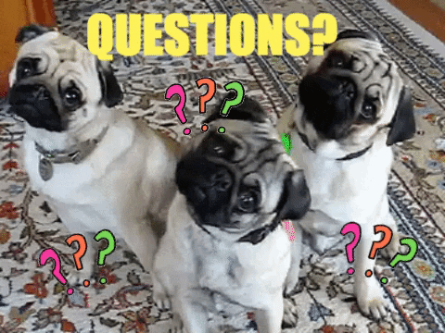
Questions? Now or Later
Becky Spratford
  bspratford@hotmail.com
  RA for All
  Twitter: @RAforAll
Autumn Friedli
  afriedli@tscpl.org
  tscpl.org/podcast
#NoveListDayofLearning
Notes:
Image url: https://media.giphy.com/media/XHVmD4RyXgSjd8aUMb/giphy.gif

Slide 41
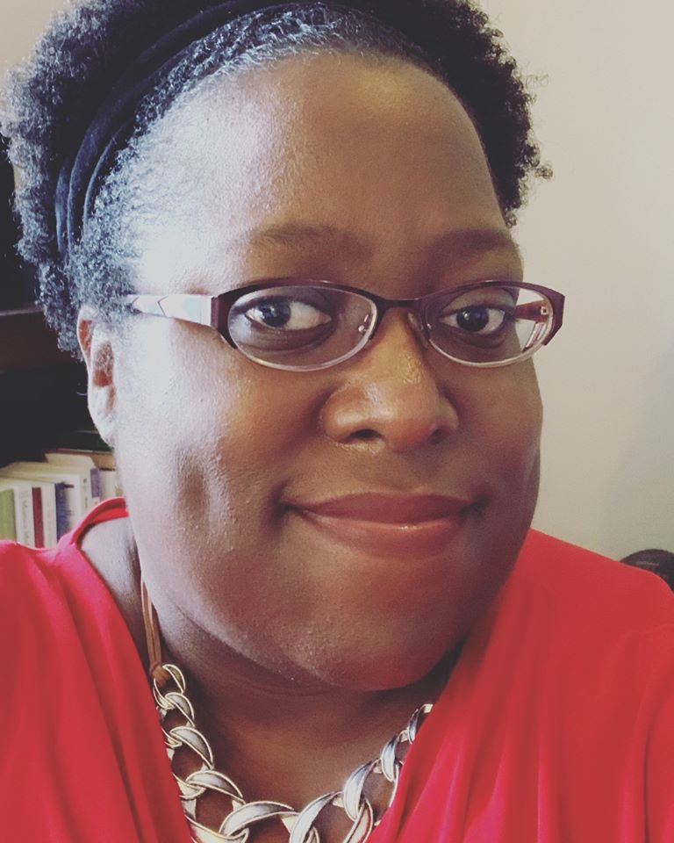
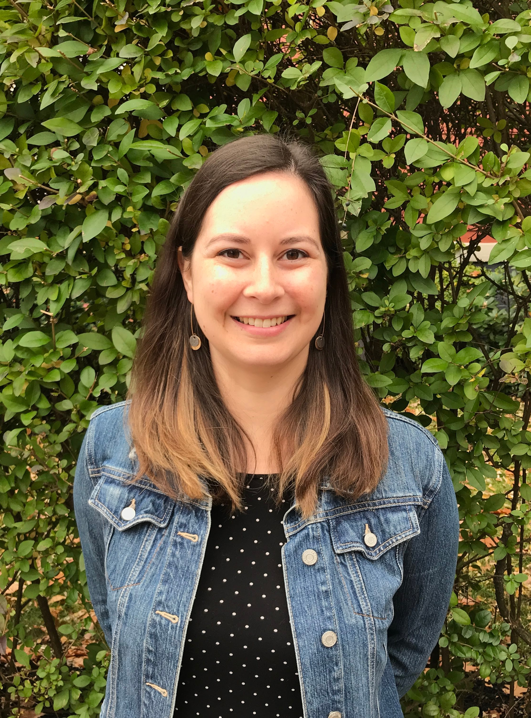

Islands in the Stream
Navigating the Waters of Collection Development
Presenters
Robin Bradford
Kendal Spires
Collection Development Librarian
Collection Development Analyst

Slide 42

ISLANDS IN THE STREAM
Welcome to the world of Collection Development

Slide 43
Presenters
Robin Bradford
Collection Development Librarian
Kendal Spires
Collection Development Librarian

Slide 44
I'm here, now what?
Whether Collection Development is one of your brand new duties... or whether it's just an ordinary Tuesday...
01
There will likely be a day when you'll stare at the screen and not know where to start.
02
The good news is that you can start anywhere!
03

Slide 45
If you're brand new to everything...
Get familiar with your tools.
1
Become an explorer.
2
Ask a tour guide.
3
Get familiar with your landscape.
4
Know your limitations.
5

Slide 46
Get familiar with your tools
How do you do selection at your library?
  Do you have a primary vendor? Multiple vendors?
Where have you been discovering titles?
What are the things specific to your library that are required for selection?
  The "how to" for your location
  Differences specific to a subject area (Children's selection vs. Adult or Fiction vs. Non)
  Differences specific to format
What processes do you need to know about?
  Setting up carts
  Sending carts
  Working with adjacent departments (cataloging, etc.)

Slide 47
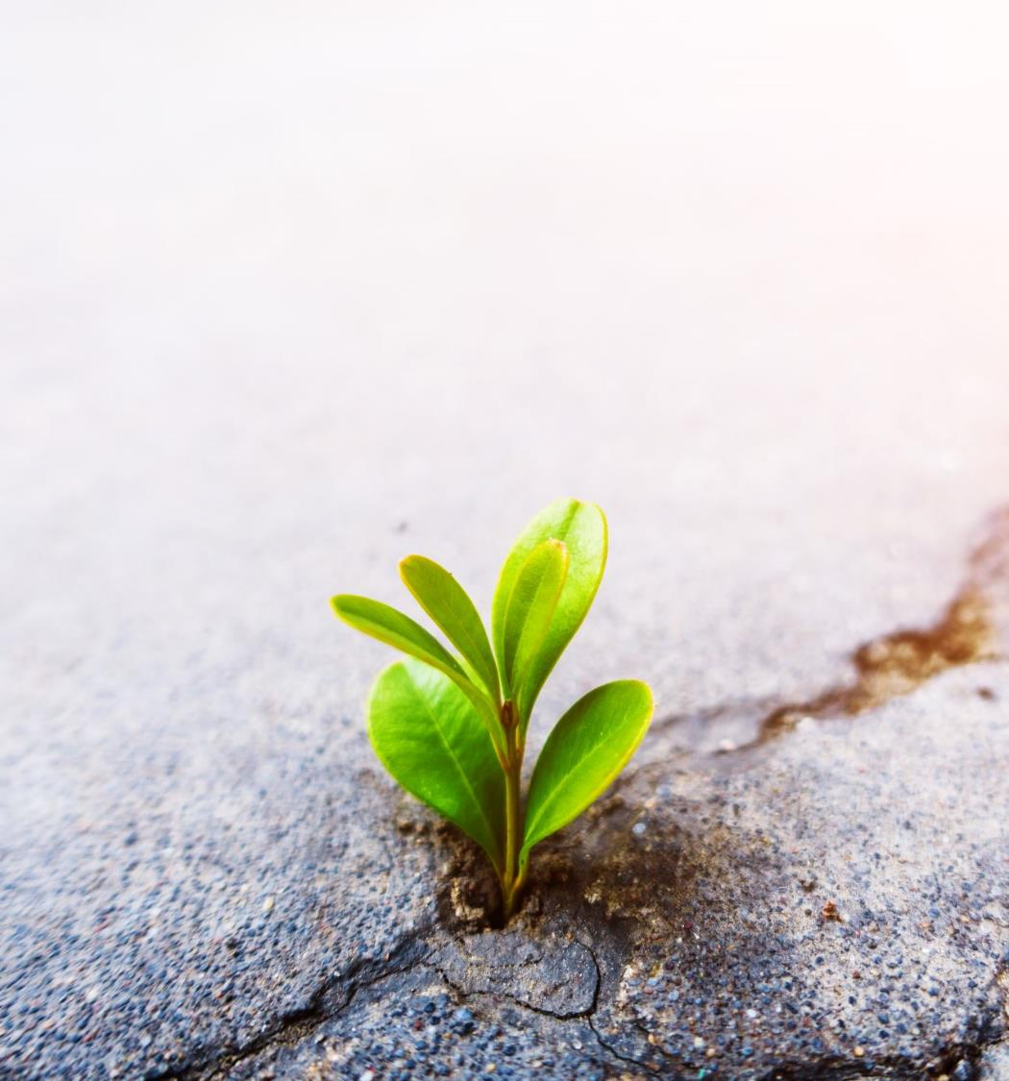
Become an Explorer
Look everywhere for materials – allow space for Discoverability.
Don't be afraid to try something new (within reason).
It's okay to settle into a process.
What works for others may not work for you.
Everything about Collection Development is trial and error.
Keep an open mind.

Slide 48

Ask a tour guide
Talk to people who have done this at your library.
Talk to people outside your library who also have collection development experience.
Take a holistic approach to collection development.
  Talk to catalogers.
  Talk to shipping & receiving.
  If you only do collection development, talk to public services staff (ALL staff, not just librarians).

Slide 49
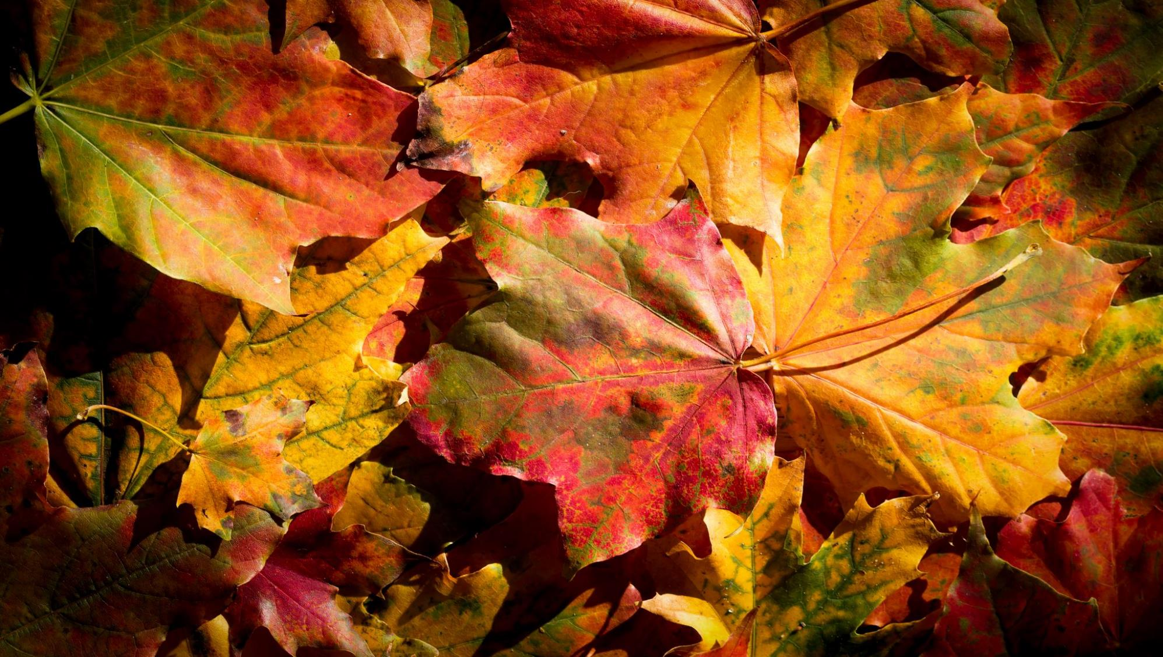
Get familiar with your landscape
Landscape = Collection Development Areas.
Discover the old standbys in your area.
Discover what is popular.
Look for ways to expand.

Slide 50
Know your limitations
Know
how much you can spend.
Know
any restrictions for your area and overall.
Such as age cutoffs for collections, format specifics, etc.
Know
how the entire process works.
A lot of things done on the selection end can make life easier down the line. Your coworkers will love you.

Slide 51
Not new, but feeling unsettled...
Make
Make a "to get done" list then prioritize.
Pick up
Pick up unfinished projects.
Do
Do the most fun thing about your job or Do the worst thing and use the other as a reward.
Look
Look at statistics.
Start
Start work in a different area.

Slide 52

Make
A "to do" list is immediate. A "to get done" list is an exercise to try and rein in wild and wandering thoughts.
It can be a concrete list or an aspirational list.
Use this as an exercise to settle thoughts.

Slide 53
Pick up
Collection Development can be a series of ongoing projects.
If you have multiple subject areas, move to a new one.
If you have other collection responsibilities (weeding, statistics, patron requests) move to one of those.
Again, the purpose is to give your brain a break so you can regain focus.

Slide 54
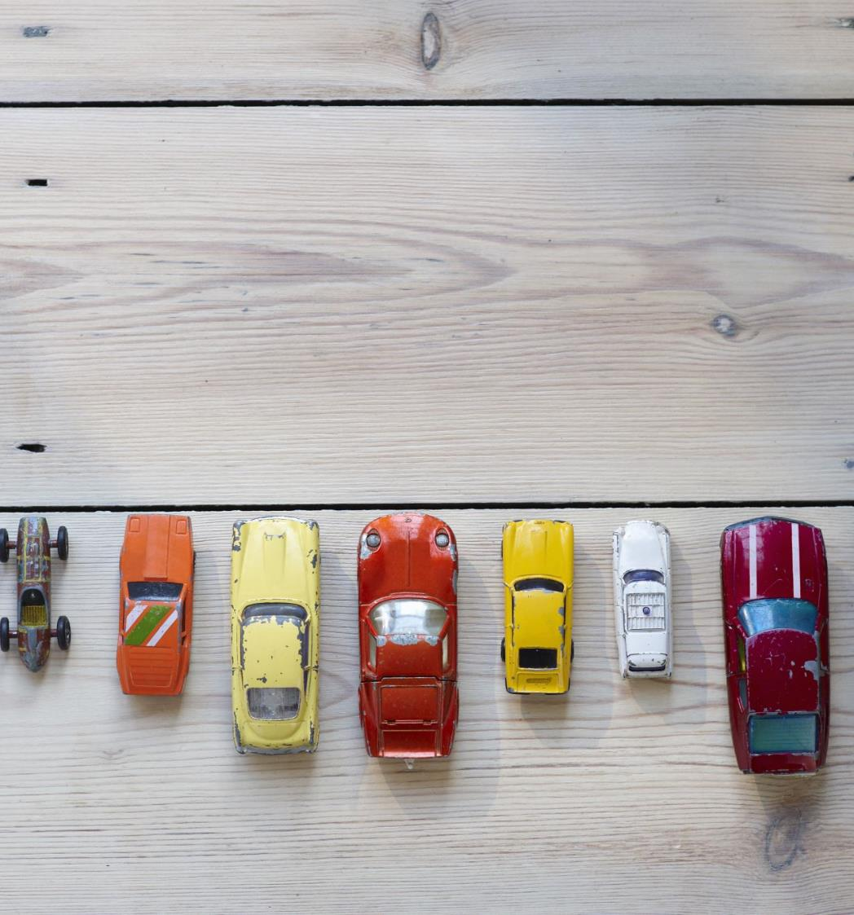
Do
Do the most fun thing about your job.
Do the least fun thing about your job and use the most fun thing as a reward.

Slide 55

Look
Look at statistics.
Calculate (I know, I know!) some numbers.
Look for new ways to measure performance.

Slide 56

Start
If you have other responsibilities, switch to those.
Move around in collection development.
The key is to do something different to jumpstart motivation.
When all else fails, I look for cake.

Slide 57

Don't be afraid of change
But also, make *thoughtful* changes.
Make the distinction between corrections and changes.
NOTHING IS LIFE OR DEATH.
Get comfortable with making mistakes and then learning from them.
Ask for help, advice, guidance, and ideas.

Slide 58
Leave your mark
It doesn't matter if you're temporarily filling in or permanently taking over
It doesn't have to be in a big and flashy manner. Subtle changes work as well.
Don't forget to check your progress.

Slide 59
Thank you!
Any questions?

Slide 60
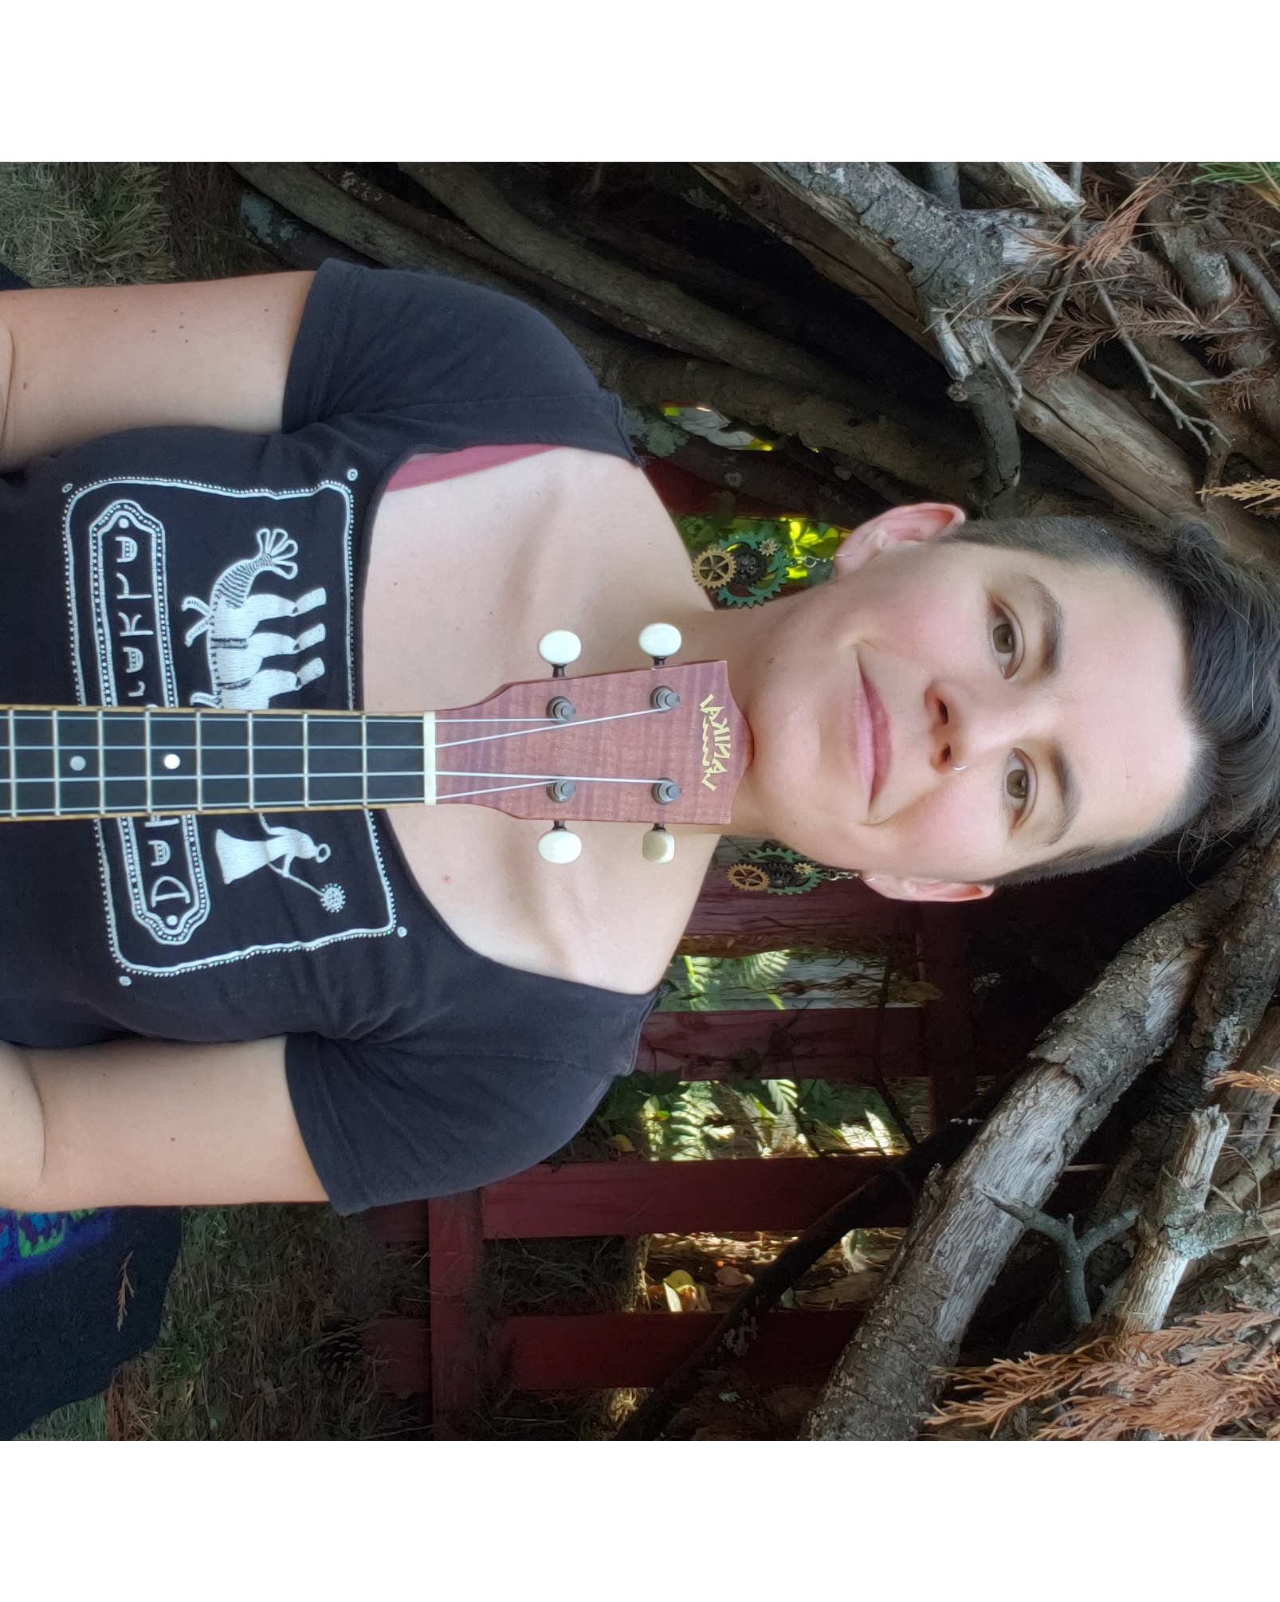
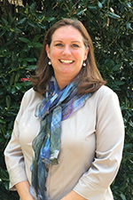
Digital Storytelling
Moving Your Storytime Online
Presenters
Amy Godfrey
Brierley Ash
Little People, Big Questions
Metadata Librarian
Conscious Storytime

Slide 61
Digital storytelling
Moving Your Storytime Online
Notes:
Brierley:
Welcome to Digital Storytelling: moving your storytime online.

Slide 62
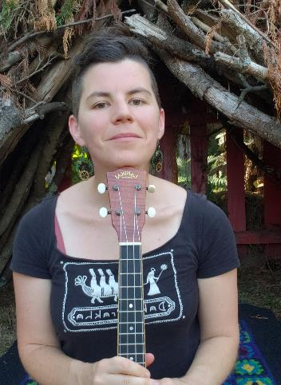
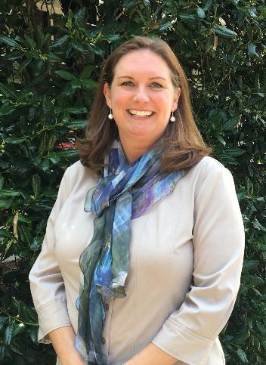
Meet
Our Presenters
Amy Godfrey
Brierley Ash
Little People, Big Questions
NoveList Metadata Librarian
Notes:
Brierley:
Introductions

Slide 63
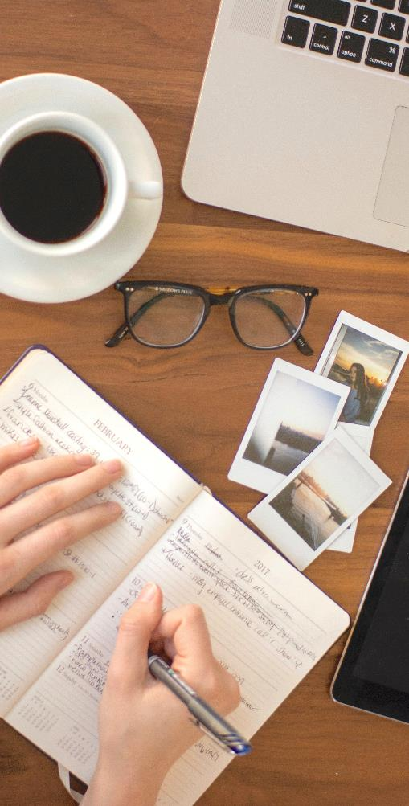
Agenda
Storytelling tools
Storytelling platforms
Engagement
Questions
Notes:
Brierley:
Go over agenda and then pass over to Amy.

Slide 64



Digital Storytelling Tools
Camera
Headphones
Microphone
Computer
Phone
External recorder
Notes:
Amy:
Camera
Computer
Phone
External recorder
Mic
Headphones

Slide 65
Which
Platform?
Live Platforms
Prerecorded Platforms
Notes:
Amy:
Live vs Prerecorded:
Live:
More connection/interaction
Faster
Prerecorded:
Takes more time
Editing
More future value

Slide 66
Live Platforms
FACEBOOK LIVE
INSTAGRAM LIVE
ZOOM
YOUTUBE LIVE
Notes:
Amy:
Instagram Live
Watch live or can save to IGTV for watching later
Can’t see kids
They can interact via comments (with grown-ups help)
Can only record in portrait-mode
Facebook Live
Watch live or can save to facebook page for watching later
Can’t see kids
They can interact via comments (with grown-ups help) - commenting on facebook is less reliable, often comments only show-up after you log out.
Can only record in portrait-mode
Youtube Live
Must have 1000 subscribers to livestream on mobile
More options and flexibility
Can record to for watching later
Zoom
If you’re doing regular events worth paying for subscription
Can see kids to interact directly or mute and interact through comments
Can record for watching later (if you have paid subscription)

Slide 67
Prerecorded Platforms
YOUTUBE
VIMEO
Notes:
Amy:
Youtube
Vimeo
editing

Slide 68

ENGAGING THROUGH SCREENS
Notes:
Amy:
Always ask questions, even if they can’t respond directly to you.
Give them time to answer, even if you can’t hear the responses.
Pretend you are talking directly to a child in front of you, and not a camera
Use names

Slide 69
Thank you!
Amy Godfrey| Little People, Big Questions Brierley Ash| NoveList Metadata Librarian
amygodfrey@gmail.com
bash@ebsco.com
Notes:
Brierley:
Thank you for joining us
Any questions??

Slide 70
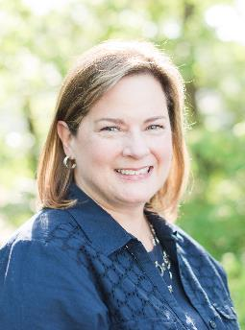
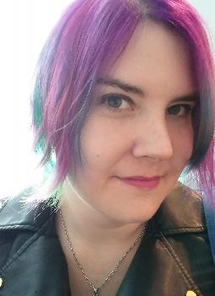
Surprise!
Contactless Browsing to Keep Readers Coming Back
Presenters
Elena Gleason
Kathy Lussier
Readers’ Advisory Librarian
Manager, Engagement and Services
elena.gleason@hillsboro-oregon.gov
klussier@ebsco.com

Slide 71


People really miss the library.
Notes:
Since the start of the pandemic, my library has gotten SO MANY lovely comments about how much people miss the library. Despite virtual and curbside services, many people still feel disconnected from the library when they can’t come in and browse.

Slide 72
How do you help browsers when your stacks or even your entire library buildings are closed?
Surprise Bundles and Bags
Personalized RA
Provide a Window into the Library
The Return of the Book Talk
Virtual Browsing
Notes:
So how do we help these browsers engage with the library in a way that’s meaningful to them? Ideas that can be scaled and adjusted to use regardless of library size, service level, or budget.

Slide 73
Surprise Bundles and Bags

Slide 74
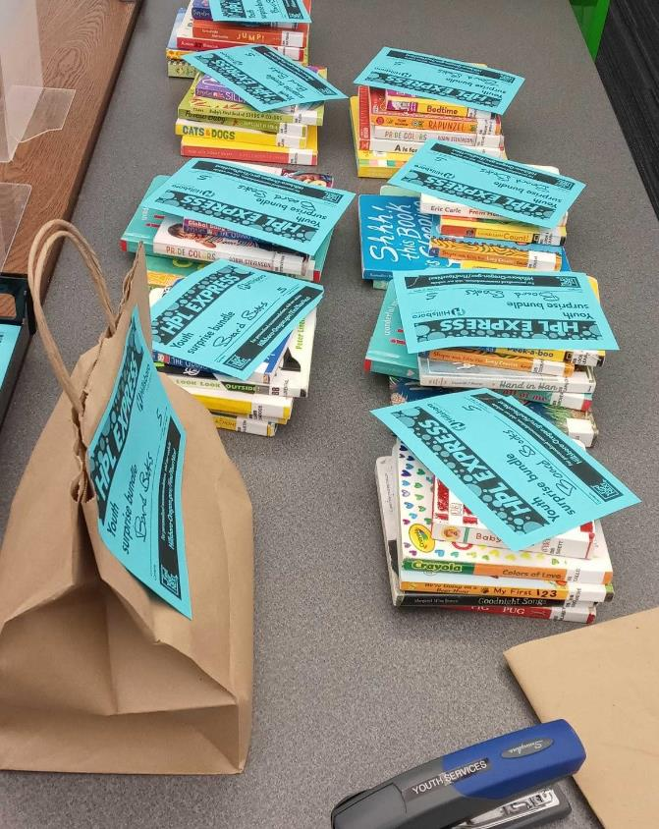
Surprise Bundles at Hillsboro
5-7 items in a paper bag, labeled with a category and quantity
Currently 28 categories encompassing books and AV for kids, teens, and adults in English and Spanish
Notes:
Hillsboro is a city of a little over 100,000 about 30 minutes west of Portland. 2 library locations

Slide 75
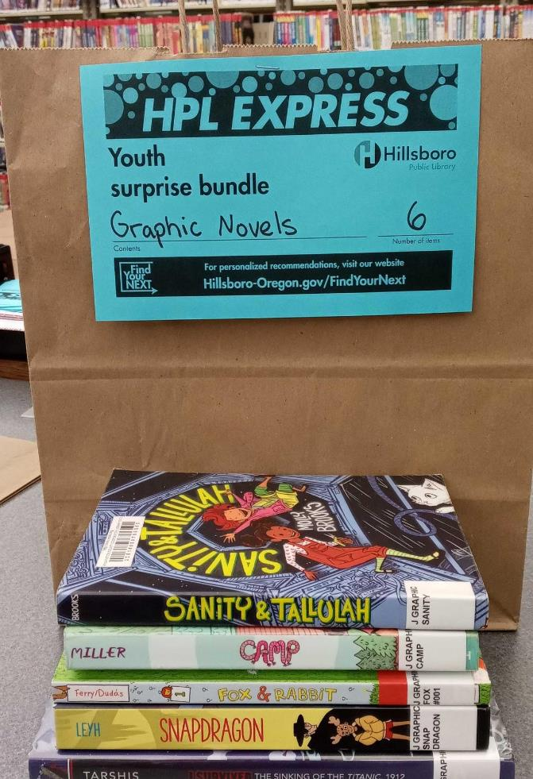
Surprise Bundles at Hillsboro
Contents check out on self-checkout machines using RFID
Grab and go only - not holdable or customizable

Slide 76
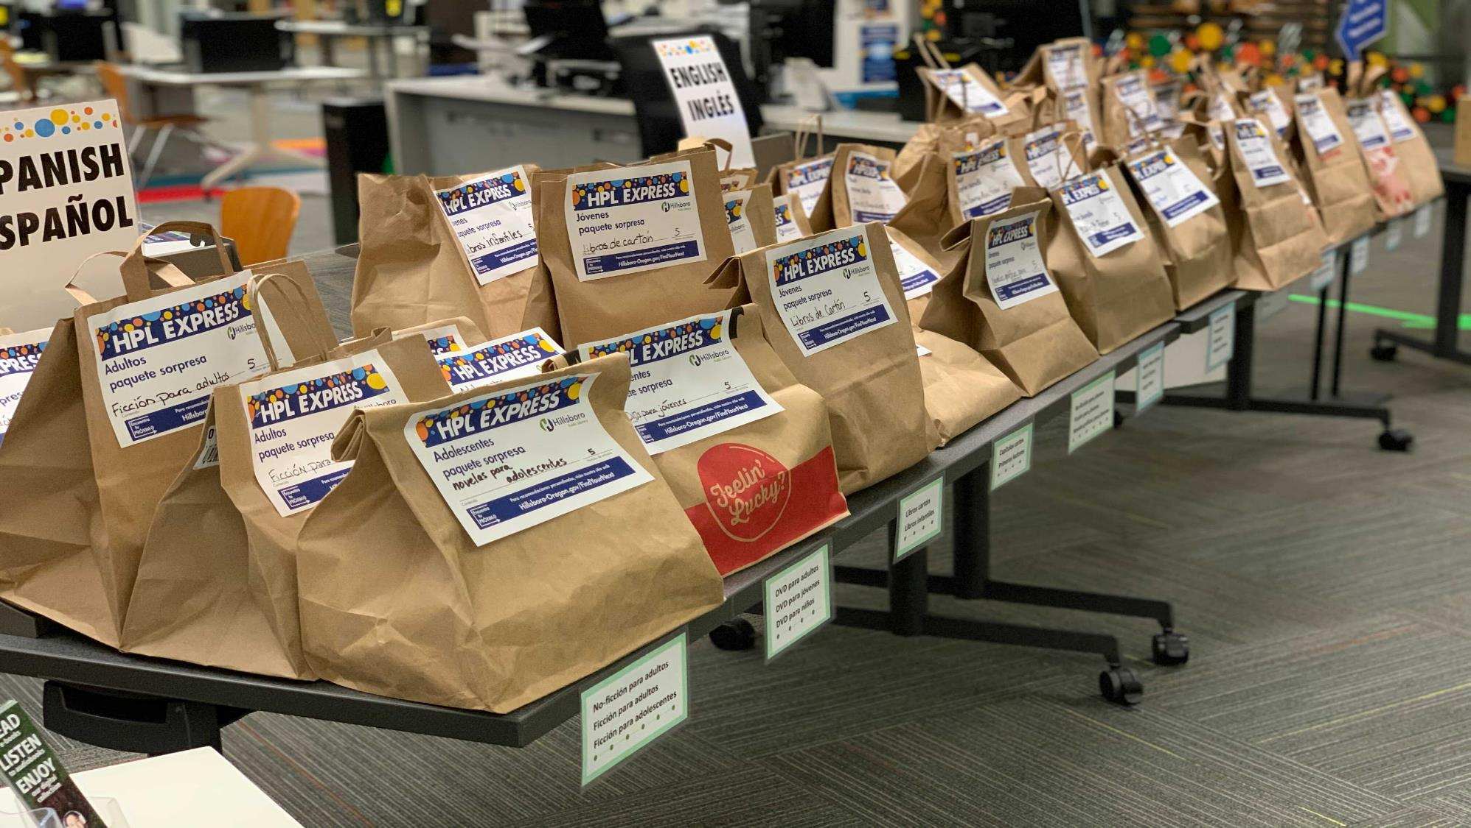
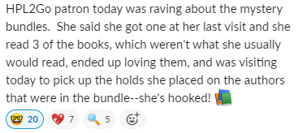

Slide 77
11,426
surprise bundles created at the Hillsboro Public Library between August 2020 and December 2020
Notes:
Doesn’t include bundles created in July before we started tracking, or bundles created so far in 2021. About 2/3 children’s, 1/4 adult, remainder YA.

Slide 78
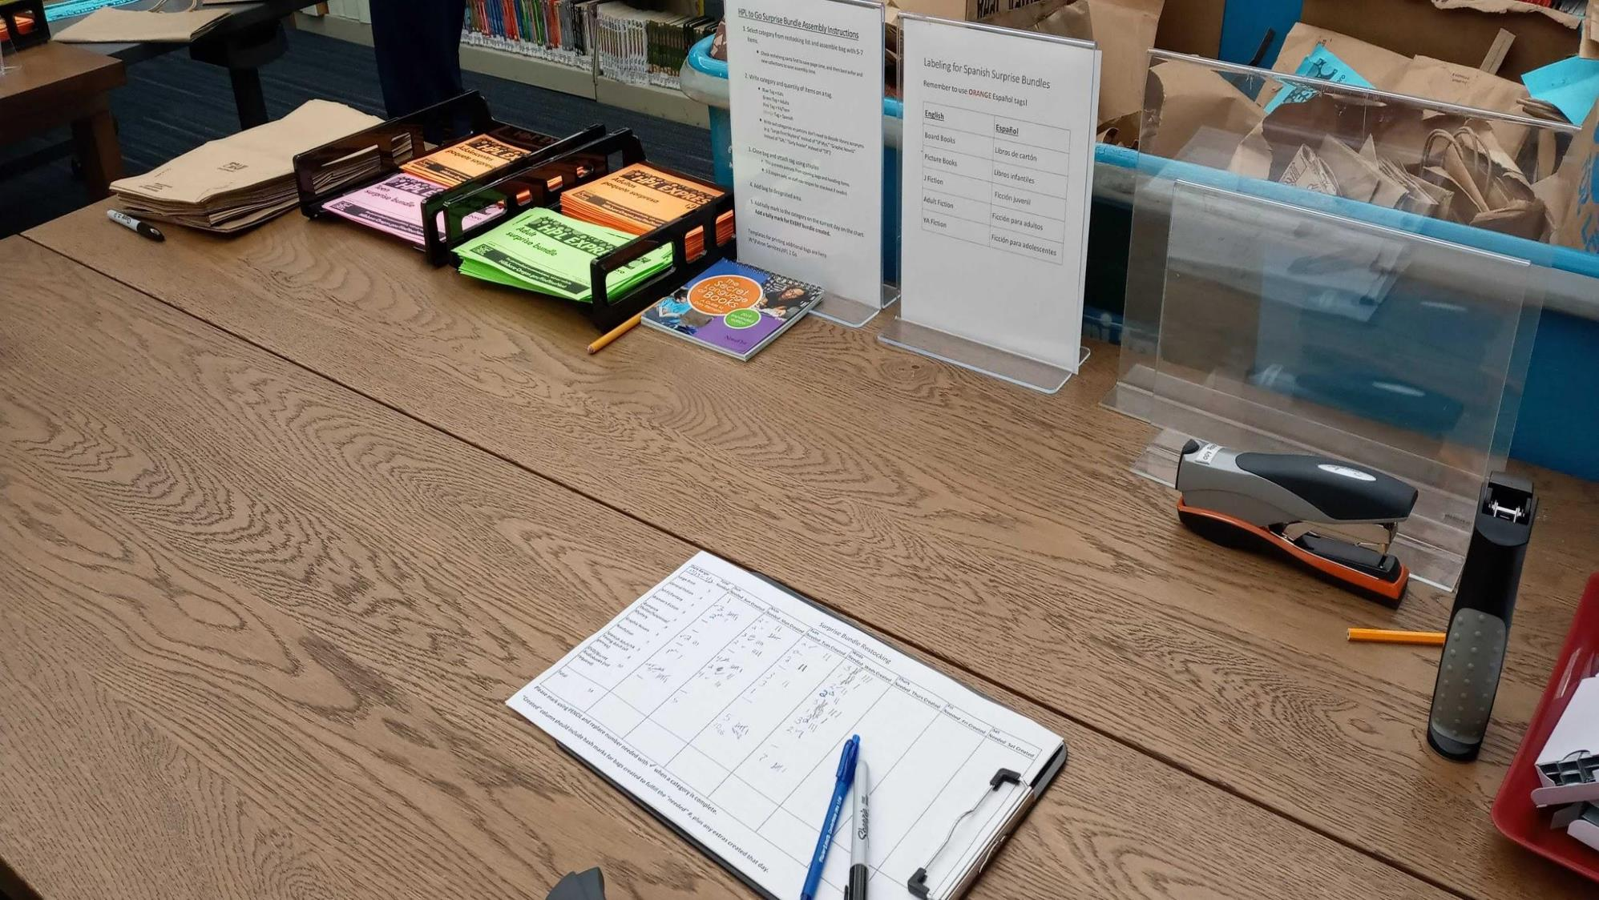

Slide 79
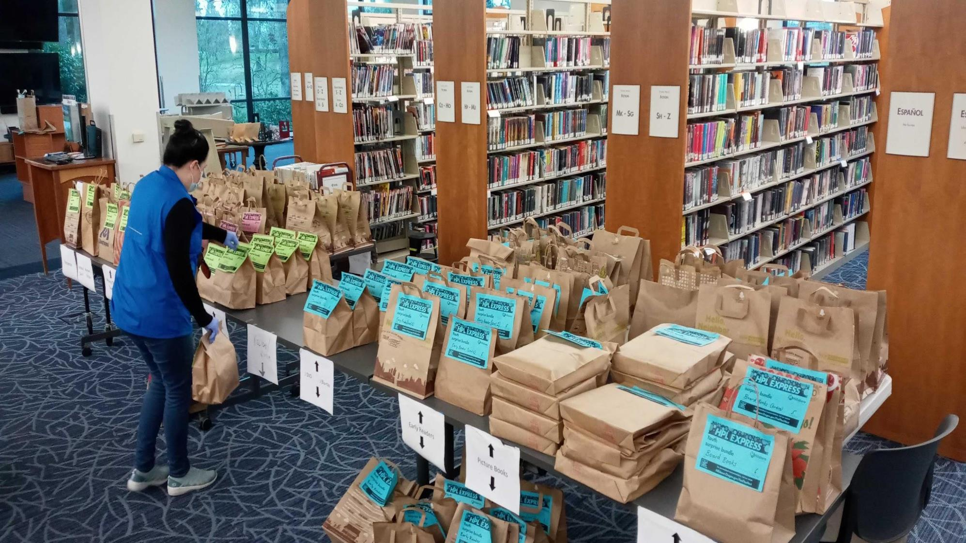
Notes:
Color coding

Slide 80
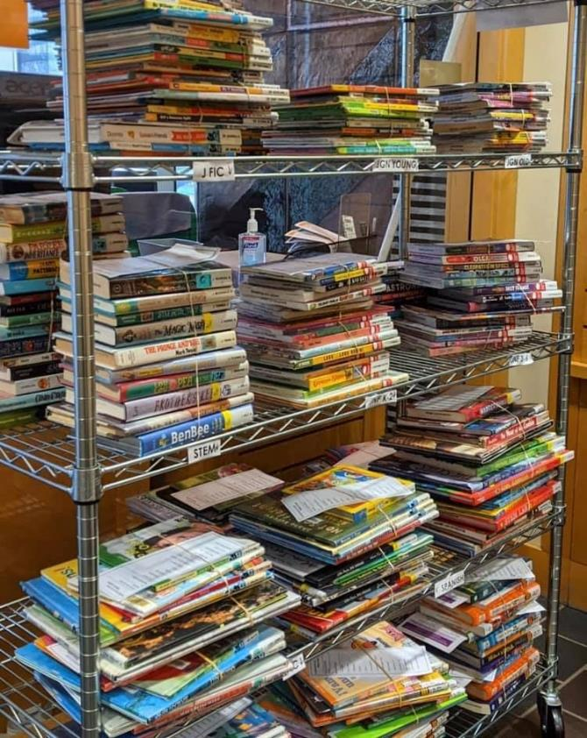
Questions to Start With
Pre-made or on demand?
Generic or customized?
Which categories?
How many bundles will be needed to meet demand?
How many items per bundle?
Who will create them? When?
Image Credit: Beaverton City Library
Notes:
If you are thinking about starting, expanding, or altering a bundle service...
3. What genres or subjects are most popular? How many categories are practical for staff to keep stocked?
4. Do you have time and space to create back stock?
6. Staff will need dedicated time for bundling. We estimate experienced RA staff can create around 10 bundles per hour.

Slide 81
Scale it for Your Library
Less Intensive
More Intensive
Bundles are Life
Create a set number of bundles per day or per week, available “while supplies last.”
Choose only the most popular collections to keep workload down and manage patron expectations.
Add more categories based on patron demand.
Add bundles to your catalog and allow patrons to place holds.
Offer custom bundles created to order.
Create bundles using appeal terms, e.g. “Moving and Own Voices,” “Quirky and Heartwarming.”
Notes:
1. Decide on a specific list of categories: Don’t create really specific bundles unless you’re prepared for patrons to demand the same category on their next visit!
2. Holds: Tualatin’s movie bundles
3. Custom bundles: A patron wants cozy mysteries? Dinosaur picture books? Comedy DVDs? Create a bundle just for them!
Appeal: See NoveList, LibraryAware

Slide 82
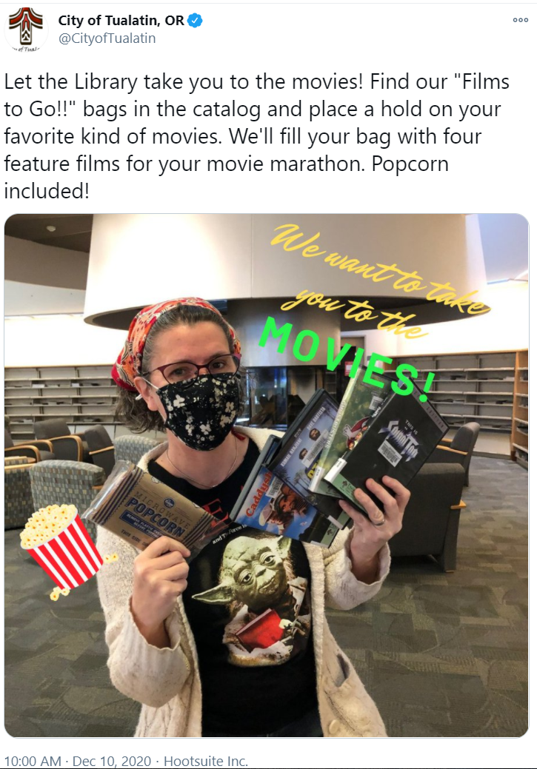
Tualatin Public Library Films to Go!!
Image Credit: City of Tualatin

Slide 83
Bundle Tips and Tricks
Keep Backstock
Set out a limited number of bundles but keep extras on hand for restocking. Just don’t overdo it!
Bag Donations
Local grocery stores are often willing to donate paper bags.
Save Your Shelvers!
Pull bundle contents from shelving carts and help save your shelvers’ time.
Include Quantity on Your Label
If you intend patrons to keep bags closed during checkout, include item quantity on your label.
Use Bundles for Promo
Include event guides, promotional bookmarks, etc. in your bundles to help market library events and resources.
Appointment Only?
Add a bundle request to your appointment form.

Slide 84
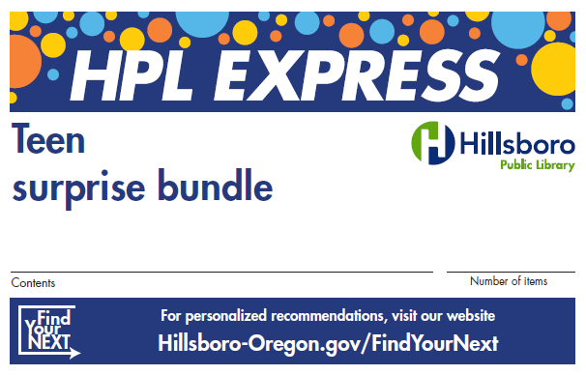
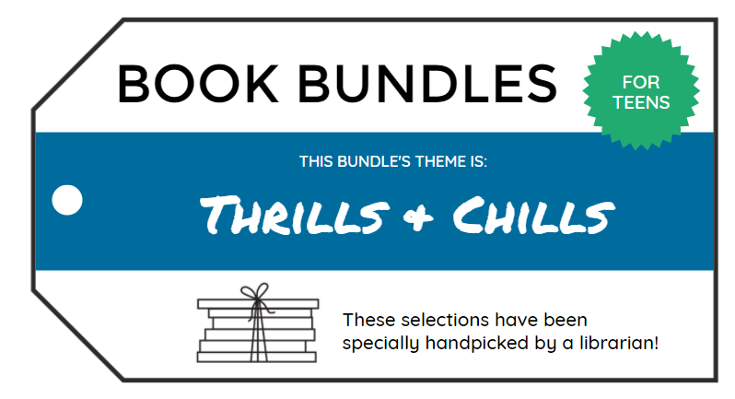


Bundle label examples from Hillsboro Public Library (upper left), LibraryAware (upper right, bottom)

Slide 85
Personalized Readers’ Advisory Services

Slide 86
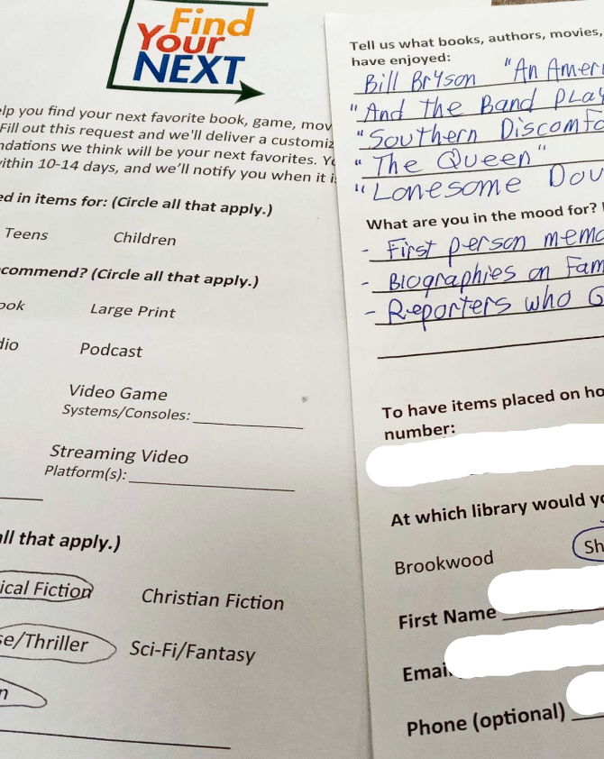
Put Those RA Forms to Work!
Revisit your RA form (or create one)
Does your old form hold up to new circumstances?
Is it kid and parent-friendly?
Do you offer more than books?
Notes:
Many libraries have web forms, but this is a great time to revisit them considering the new circumstances we find ourselves in. Many RA forms were created for power users who are avid readers. Do your questions work for patrons who are once and future browsers? Are they kid-friendly? Do you offer suggestions beyond books? If your form is in great shape, promote it, and be ready to handle the flood of responses!

Slide 87
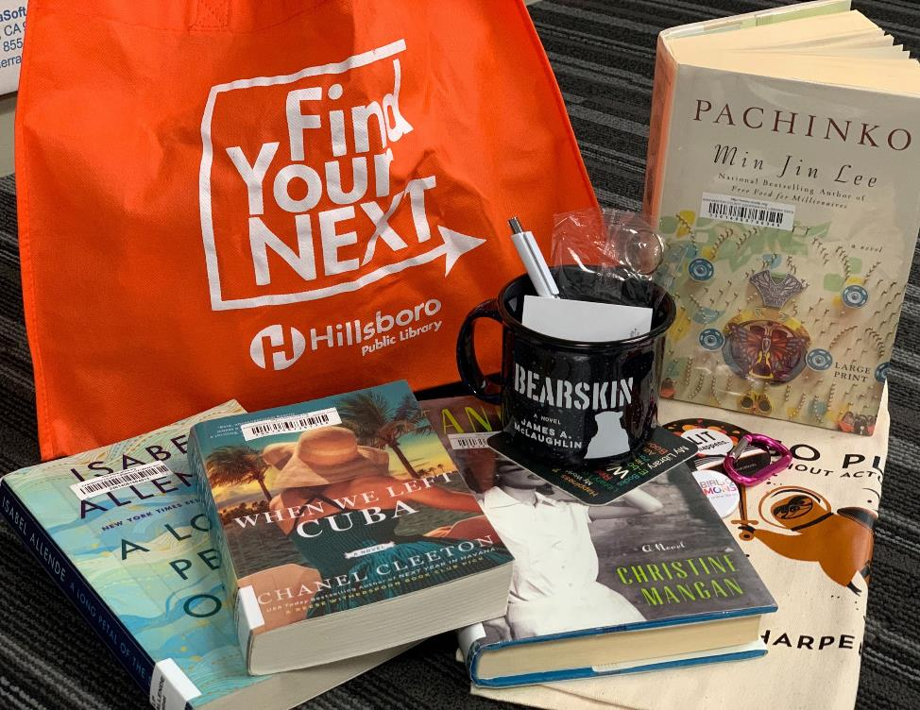
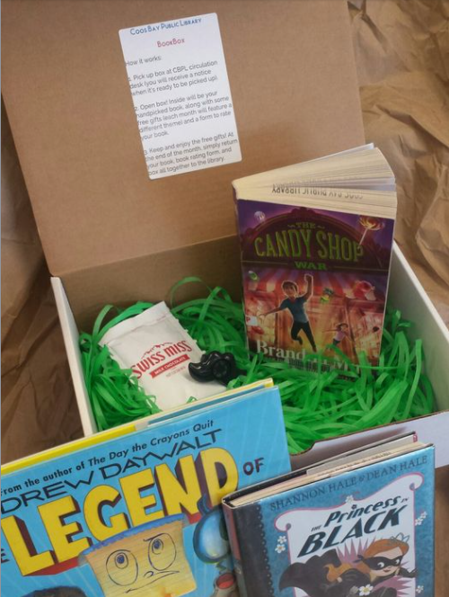
Custom bundles, boxes, or totes
Hillsboro Public Library’s Find Your Next service
Image Credit: Coos Bay Public Library
Notes:
Swag optional. See also: Happy Valley

Slide 88
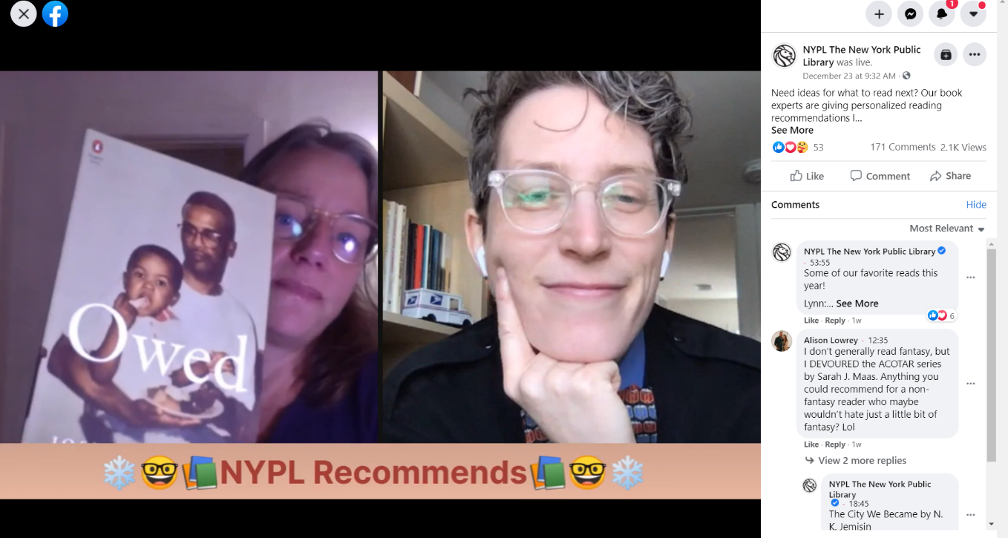
Go Live!
Image: New York Public Library Facebook Page
Notes:
If your library has a large Facebook following, consider a live broadcast to offer on the spot recommendations. This is Lynn and Emily from NYPL. Weekly hour-long broadcasts since April!
Be.Live. Be prepared with filler for lulls between questions--HPL’s FB Live events turned into just book talk shows!
Camera shy? Try taking requests in the comments of a post--this works great for all social media platforms. HPL had our most success with offering recommendations on Instagram!

Slide 89
Provide a Window into the Library

Slide 90
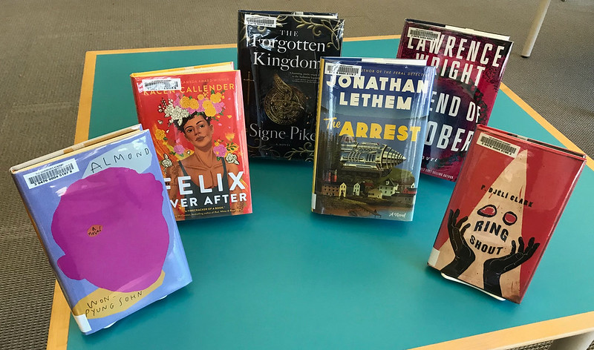
Photos of New Books
Great new books languishing without browsers to find them? Snap a quick photo and share on social media!
Make it fancy: Include brief blurbs for a couple titles and add links to your catalog.
Image credit: Flickr: Pesky Librarians
Notes:
It’s best to share an actual photo of your shelf instead of a stock photo or cover images because one of the things your browsers are really missing is the FEEL of their library. Seeing the books IN their favorite space ignites the warm fuzzies.

Slide 91
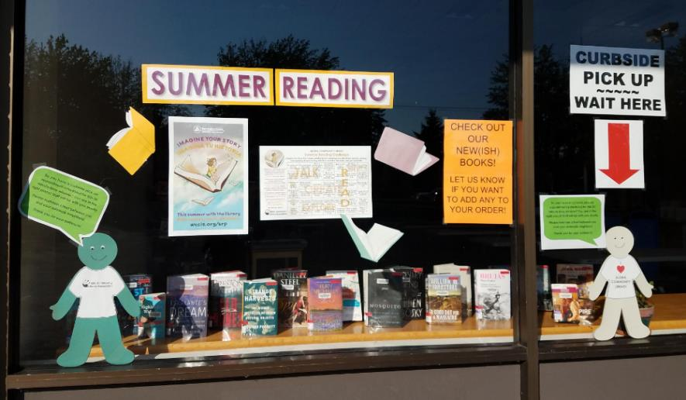
Window Shopping
If your library gets a lot of foot traffic, create a bookstore style window display with instructions for how to get the books (place a hold or ask staff now).
Make it fancy: Add a QR code linking to your catalog.
Image Credit: Aloha Community Library Association

Slide 92
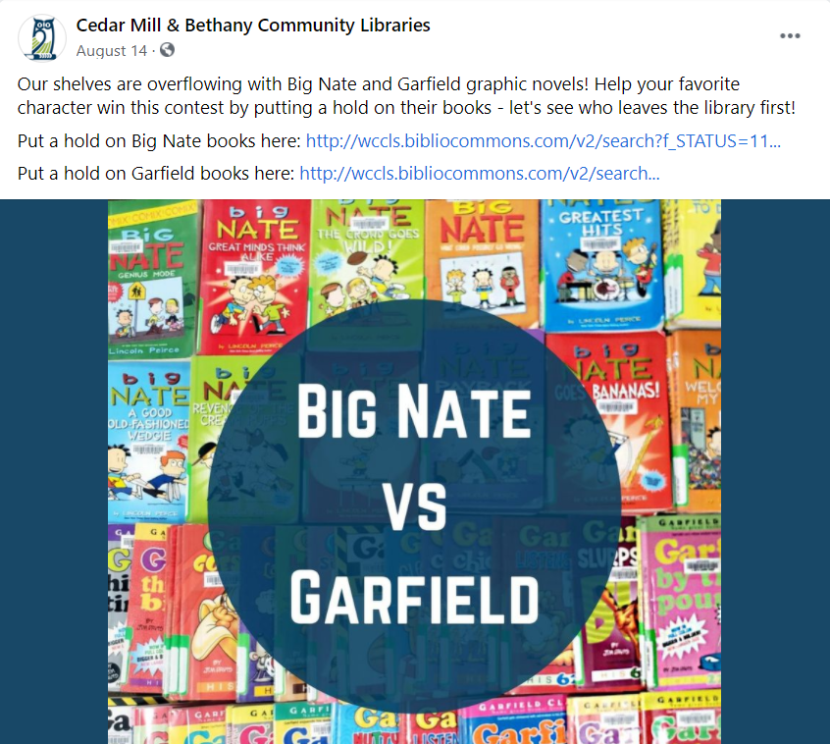
Battle of the Holds!
Clear out overcrowded shelves and remind patrons about their favorite series with a popularity contest on social media.
Image: Cedar Mill & Bethany Community Libraries Facebook Page

Slide 93
The Return of the
Book Talk

Slide 94
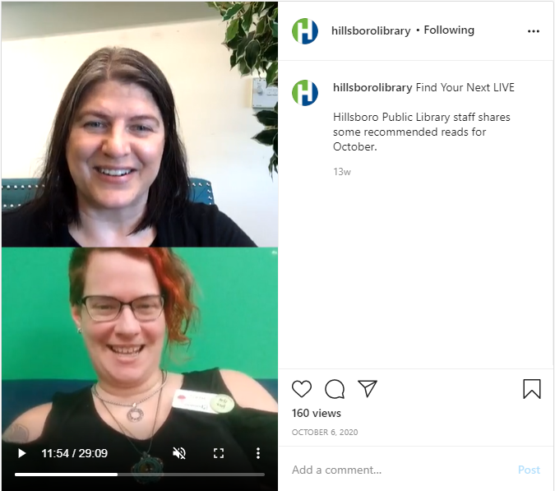
Book Talk Videos and Broadcasts
Format:
Instagram or Facebook Live
Pre-recorded videos
Slides with voiceover
Content:
Staff picks
New books
Themes
Find Your Next LIVE on Hillsboro Public Library’s Instagram
Notes:
So many different ways to do this!
HPL IG Live
Book Bites
Live new book browsing
(Next slide: 3 on a Theme)

Slide 95
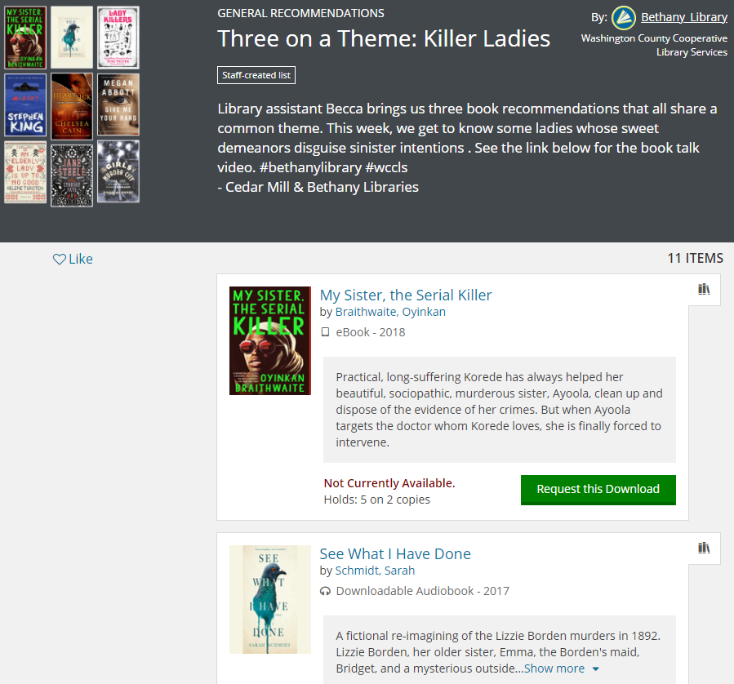
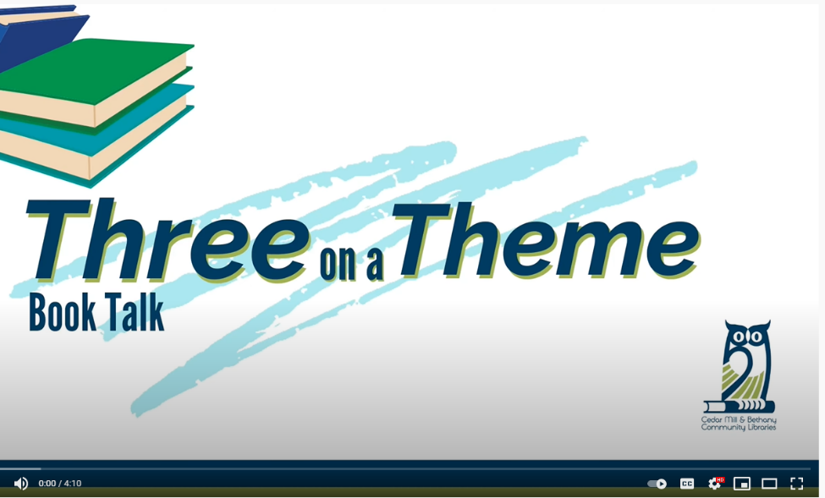
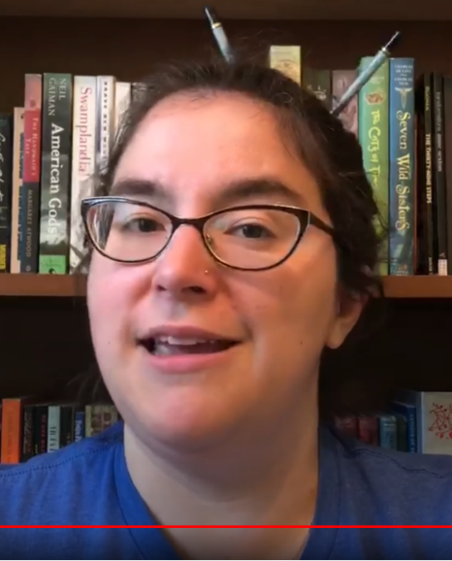
Book Talk Videos and Broadcasts
Three on a Theme from Cedar Mill & Bethany Community Libraries
Notes:
Becca at Bethany

Slide 96
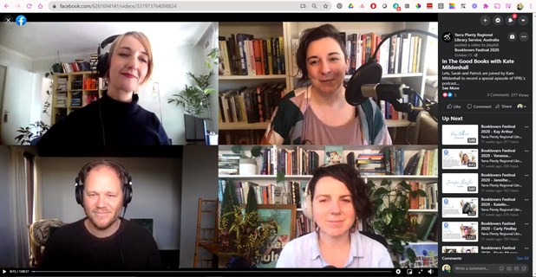
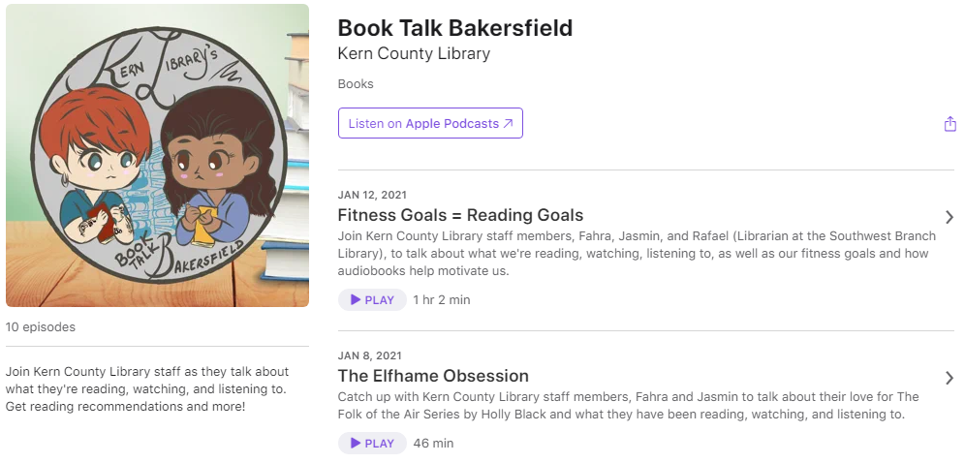
Podcasts
Left: In the Good Books podcast from Yarra Plenty Regional Library, Australia
Bottom: Book Talk Bakersfield from Kern County Library

Slide 97
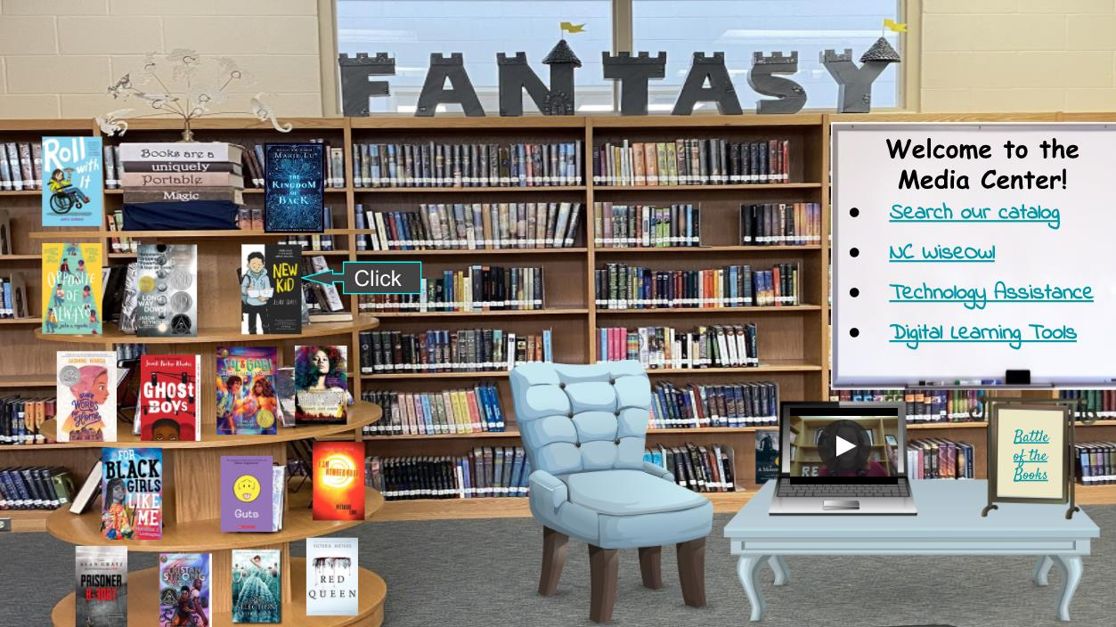
Notes:
Have you heard of Bitmoji classrooms and libraries? This is a really great idea for school libraries and teen departments.
Book covers link to book trailers on YouTube, helpful links on right, laptop screen plays video of Media Specialist Angel Murdoch welcoming students and providing an introduction
https://www.slj.com/?detailStory=virtual-libraries-bitmoji-classrooms-bring-new-kind-book-browsing-covid-19-coronavirus
Kathy Lussier with NoveList is now going to share some ideas she’s seen…Kathy?

Slide 98



Ideas from other libraries…
Notes:
Thanks, Elena!
One of the things I love about working at NoveList is getting to talk with all sizes of libraries in all different kinds of towns and even countries – some are nearby and others across the globe.

Slide 99
Virtual Browsing
Turn your homepage into a digital end cap.
Turn inboxes
into bookshelves.
Show off
New Releases in
new ways.
Notes:
I want to focus on three ideas I’ve seen from our customers for offering your patrons a virtual browsing experience, all of which can be replicated by any library. Let’s take them one at a time.

Slide 100

Turn your homepage into a digital end cap.
Notes:
Number one, turn your homepage into a digital end cap. This means giving patrons cues on your website just like you do in the library with your endcaps. Let me show you what I mean…

Slide 101
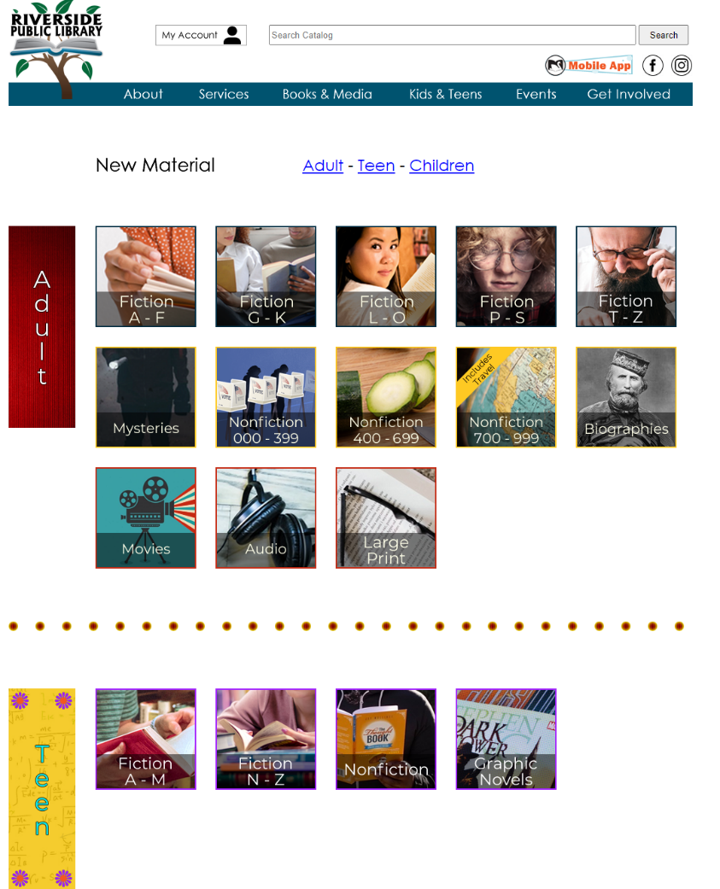
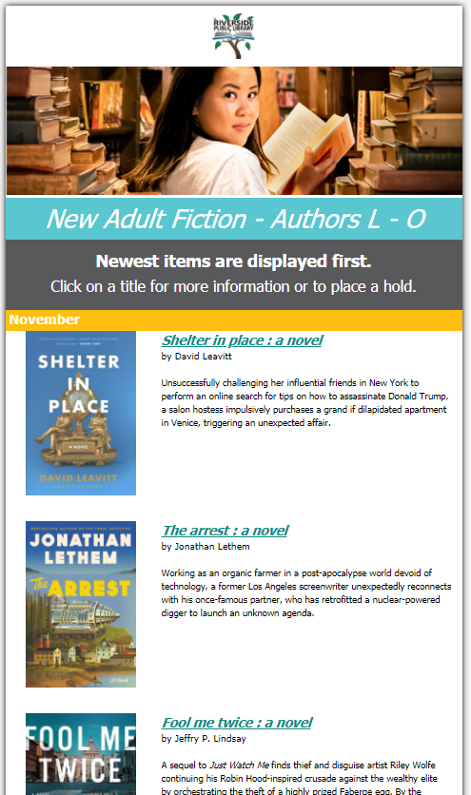
Notes:
When I saw how Riverside Public Library in Illinois provides a virtual browsing experience, I thought it was absolutely brilliant. They've created widgets, or what some people call "tiles" on their website for different categories. So, think of each category as an endcap that shows what’s included in the stack you’re about to browse. The patron clicks on the category they want to explore, and depending on how you set things up, they might end up at a catalog search, or at a booklist with details on each title in the category, like Riverside does. Either way would be simple for any library to recreate. The key is to not only show off your collection, but to make it easy for patrons to check out the book. In Riverside's example, patrons can click on the book jacket, or title to go directly to that item in the catalog and place it on hold.

Slide 102
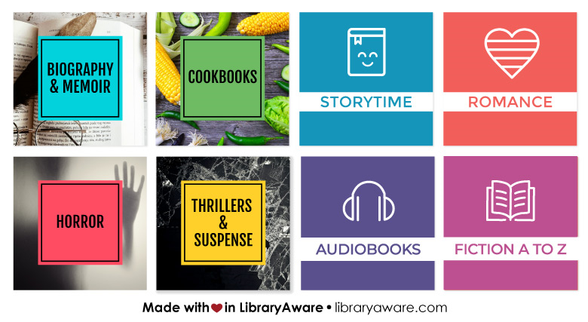
Search: virtual browsing
Notes:
For libraries that have LibraryAware, you'll find a great selection of ready-to-post widgets that you can use on your homepage and link to a catalog search, the latest issue of NextReads newsletters for that genre, or to a custom book list. Just search the words "virtual browsing" in LibraryAware to find them.

Slide 103

Show off your New Releases in new ways.
Notes:
Number two, show off your New Releases in new ways. Patrons love to browse your new releases shelves, right? So what can you do if your stacks are closed for browsing?

Slide 104


Notes:
You can do what Fresno County Library does…
After they closed due to COVID, staff started getting calls daily from patrons who wanted to know what was on their popular “New & Now” shelves. I know many of you went through something just like that!! Well, after handling these calls over and over again, Fresno’s team thought “there has to be a better way.” And there was!
They wanted to recreate that visual experience of seeing the book jackets and DVD covers on the New & Now shelf on their website. So, they used LibraryAware's book carousels combined with their own custom lists of the new releases to give patrons that sense of discovery that browsers love. And it's been a big hit. In fact, patrons and staff have enjoyed the page so much, they're working on a similar page that highlights other parts of their collection!

Slide 105

Turn inboxes into bookshelves.
Notes:
And number three, Turn inboxes into bookshelves.

Slide 106



Notes:
Boston Public Library has sent out a monthly newsletter about programs and events for a long time. But when COVID hit and their libraries closed, they realized most of their readers’ advisory was based around browsing in person. That wasn’t an option anymore. They needed a new way to provide readers’ advisory from a distance.
They decided to move their browsing-based RA to newsletters, each focused on a particular topic or genre, like this one for Biography & Memoir. It includes several opportunities for patrons to dive deeper into their favorite genre, from spotlighting a book each month, to featuring an event like their live reading recommendations on Twitter, to new titles and more ways to find your next great read. They’re adding more newsletter genres to choose from, and patrons can sign up for as many as they’d like.

Slide 107



Keep everyone’s to-read lists full
with NextReads newsletters delivered to their inboxes
Notes:
How can you turn inboxes into bookshelves if you don’t have a large staff? LibraryAware customers have access to our NextReads newsletter service, covering a wide selection of genres and topics in fiction and nonfiction, for kids, teens and adults. These curated recommendations include hand-written descriptions that go beyond a simple annotation to let readers know more about why the book might be of interest to them. The newsletters can be sent out as-is, or customized by the library.
Link: https://www.ebsco.com/novelist/products/libraryaware/nextreads

Slide 108


Notes:
Stark Library in Canton, Ohio, also uses their NextReads newsletters, branded as Fresh Picks, to provide content for book carousels on therir website for a very visual browsing experience. Each title is automatically linked to the library’s catalog, making it easy to place a book on hold. These carousels are automatically updated whenever a new issue of each newsletter is published. Just set it and forget it!

Slide 109

Useful Resources
Custom Boxes
Burns, Ridgeway, et al. “Book Box: How a Cardboard Box Became our Trendiest Teen Program.” ILA Reporter, vol. XXXVI, issue 6, 29 November 2019. https://www.ila.org/publications/ila-reporter/article/101/book-box-how-a-cardboard-box-became-our-trendiest-teen-program. Accessed 17 January 2021.
Bitmoji Classrooms
Kletter, Melanie. “Virtual Libraries and Bitmoji Classrooms Bring a New Kind of Book Browsing.” School Library Journal, 23 September 2020. www.slj.com/?detailStory=virtual-libraries-bitmoji-classrooms-bring-new-kind-book-browsing-covid-19-coronavirus. Accessed 17 January 2021.
Notes:
We hope you've found at least one idea that you can implement right away at your library to keep readers coming back.
Before we close, we wanted to share with you some resources from our presentation. And remember to grab your Digital Swag Bag at the link provided in your registration for more resources.

Slide 110

Any questions?
Contact Us:
Elena Gleason
Readers’ Advisory Librarian
Hillsboro Public Library
elena.gleason@hillsboro-oregon.gov
Kathy Lussier
Manager, Engagement & Services
NoveList
klussier@ebsco.com
Notes:
Elena and I are happy to answer any questions now in chat…

Slide 111



Email Newsletters
Easy as 1-2-3
Presenters
Samantha Bonnette
Jessica Lin
Marketing and Development Manager
Customer Engagement Specialist

Slide 112

E-mail Newsletters:
Easy as 1-2-3
Part I: Why e-Newsletters?
Shreve Read Online Case Study
Presented by Samantha Bonnette | NoveList Day of Learning 02.10.21

Slide 113

This is Shreve Memorial Library
Caddo Parish
21 Branches
2 Mobile Libraries
1 Mobile Makerspace
1 Support Services Center
24/7 e-Branch
Notes:
Shreve Memorial Library serves the city of Shreveport and the surrounding Caddo Parish. Located in the northwest corner of Louisiana, the library system is funded by dedicated tax millages. Our mission is to transform Caddo Parish lives with resources, services and support to create a better world. We offer 21 branch locations throughout the parish, 2 mobile libraries, 1 mobile makerspace, a support services center which houses all of our administrative offices, and a e-branch that is available 24/7.

Slide 114

You can do WHAT at the Library?
Notes:
With all of these great tools at hand, I was surprised to find out that many, if not most, of our constituents were not aware of all of the great services that the library offered. In 2017, when we began to develop our strategic plan for the next 5 years, one of the comments that came up repeatedly at town hall meetings was “Oh I didn’t know you could do that at the library!” So as a marketer, I knew that one of the first things we needed to do was to do a better job at creating awareness and educating our patrons about all of the many services we offered.

Slide 115

Introducing
The Shreve Read Online
Bi-Weekly Newsletter
Opt-Out Subscription
Information Mix – Programs, Services, Updates, etc.
Book Suggestions for all ages
Notes:
Thus, the Shreve Read Online was born. Our first issue went out in March of 2017. The e-newsletter is distributed bi-weekly to all library patrons with an email address on file. The newsletter is opt-out meaning that if a patron decides they no longer want to receive the newsletter they have the option of unsubscribing or opting out. Because the newsletter goes out to all patrons, we try to cover a wide variety of topics including system-wide programs or initiatives, upcoming programs, digital services, library spotlights, etc. We also include a section on book suggestions or what’s new at the library in each issue of the newsletter.

Slide 116

Dream. Discover. Do. Shreve Memorial Library and You!
Notes:
Our vision statement for the library is “Dream, Discover, Do. Shreve Memorial Library and You!” which means all of our customers are included in that vision and we want to empower all of them to be able to dream, discover and do at the library.

Slide 117

Something for Everyone
System-Wide Events
Programs for Children, Teens, and Adults
Library Spotlight
News & Tech Updates
New Books at the Library
Notes:
So we try to include something for everyone in the newsletter. As I mentioned before, the Shreve Reads includes information on system-wide events and upcoming programs. I try to include a children’s program, teen program, adult program, and all-ages programs in each issue whether there are listed as an upcoming event, a library spotlight feature or as the headlining article. We also try to include information for those who may just want to use a digital resource so we include what we refer to as news and tech updates. In our What’s New at the Library section, we always feature a new adult, children’s and teen books.

Slide 118

Better Together
Notes:
As we all know we are better together, and the same is said of our marketing efforts at the library. The e-newsletter is just one of many marketing tools that we use at Shreve Memorial Library. The Shreve Read Online goes out to current patrons of the library, but we also try to reach as many potential users of the library as possible.

Slide 119









Marketing Efforts
Newsletters & E-mail Blasts
Billboards
Posters & Flyers
Print, Radio & TV ads
Social Media (@shrevememorial)
Website
Press Releases
Notes:
Our marketing efforts include e-newsletters, posters, flyers, and e-mail blasts for current customers as well as press releases, billboards, and paid advertisements for potential customers. Our website and many social media handles also serve as great marketing tools for both current and potential customers. All of our pieces work hand in hand. Our branding is consistent across platforms. So if you see an article promoting our One Book One Parish campaign, you’ll see the same branding on a billboard or the website or social media.

Slide 120

But then COVID-19…
Notes:
Then in March of 2020, we all were affected by the COVID-19 pandemic. Our library branches closed to the public, and services were changing daily.

Slide 121


Keeping Patrons Informed
Library Updates
Online Digital Resources
Virtual Programs
Notes:
All of our traditional in-house marketing efforts (posters, flyers, banners for programs, etc.) were no longer as effective. People were not traveling outside of their home and all of our in-house programs were canceled. The e-newsletter was and still is a very critical part of our marketing effort and a key communication tool with our patrons. It was very important to continue to distribute the e-newsletter regularly in order to keep our patrons informed. Rather than focusing on events and programs, we focused more on providing regular library updates including closures, service limitations, reopenings, etc. We also focused on promoting more heavily our online digital resources and tools that patrons could use at home. We wanted them to feel connected and know that the library was still available to them although a little differently.

Slide 122

Share Your Story
Notes:
Prior to COVID, the Shreve Read Online featured photos of patrons and staff at various library events and programs. In fact, all of the pictures you have seen so far in this presentation are actually headers for various editions of the Shreve Read online. By visually highlighting our programs, our patrons, our services, our display it allows us to tell our story through the newsletter. Not only are we promoting what’s coming up and the library, we’re able to say show what we are doing at the library and show our customers this is what’s happening at your library. It’s also fun for patrons and staff to be able to say, “Hey my photo was featured in the newsletter, did you see it?” Again this connects us to our vision statement.

Slide 123




E-Newsletter Headers Before COVID-19
Notes:
Our newsletter headers prominently featured smiling faces and activities prior to the COVID-19 pandemic closures.

Slide 124




E-Newsletter Headers After COVID-19
Notes:
After COVID-19 hit and continues to affect our region, we are still telling our library story through the e-newsletter. Instead of smiling faces and activities, we feature displays, updates to the library, new services, and our staff wearing masks, showing that we all are doing our part.

Slide 125

Measuring Success
Notes:
So far the newsletter has gotten a great response. I think what makes this one more successful than previous versions is consistency of the newsletter, frequency of the newsletter, and the readability of the newsletter. The newsletter comes out every other Wednesday, always has the same format, and does not take long to read through. If you want more information about anything that’s featured, you can click links back to our website or other sites to continue reading.

Slide 126

The Shreve Read Online
(Pre COVID-19)
Bi-weekly Distribution
Approximately 40,000 subscribers
Open rate of 12.37%
Notes:
We’ve had a great response to the newsletter. This slide shows some of our stats for the e-newsletter as well as email blasts and targeted messaging. The Shreve Read has the largest distribution of any type of email marketing that we do. The audience is a little more than 40,000 patrons. The open rate on these emails is between 11 – 13% per issue. While that open rate may be a little lower than the national average for e-newsletters, it’s great for us. My board and fellow staff members are not so much as interested in a percentage but in actuals numbers of people touched. So with each issue, approximately 5,000 people are opening and engaging with the newsletter.

Slide 127

The Shreve Read Online
(Post COVID-19)
Bi-weekly Distribution
Approximately 45,000 subscribers
Open rate of 14.57%
Notes:
Since COVID-19, our subscribership has increased as well as our open rate. Shreve Memorial Library provided digital library cards to all residents of Caddo Parish. The influx of card sign-ups corresponded to an increase in subscribers since our newsletter is opt-out. The open rate has also increased.
At the height of the pandemic closures, our open rate was 21% (which was outstanding!).

Slide 128

Notes:
This amazing piece of chalk art was done by the staff at our Broadmoor Branch, and like the monsters in the quote – e-mail newsletters are a part of our marketing efforts that are forever. Now that I’ve given you the why of e-mail newsletter marketing, I’m going to turn it over to my partner Jessica Lin to tell you how you can do your own e-mail newsletter!

Slide 129


Email Newsletters: Easy as 1-2-3
Jessica Lin
Engagement Specialist

Slide 130

Uploading a subscriber list using a bulk upload
Click the Subscribers link at the top of your screen.

Slide 131

Uploading a subscriber list using a bulk upload
Click the Add button. Choose Bulk Subscribers.

Slide 132

Uploading a subscriber list using a bulk upload
Give your bulk upload a name. Then upload a .csv or .txt file.

Slide 133

Uploading a subscriber list using a bulk upload
Type the subscriber interest group title. Click the Add link, then Import.

Slide 134

Uploading a subscriber list using a bulk upload
Click the different radio buttons to get various opt-in page links.

Slide 135

Uploading a subscriber list using a bulk upload
Opt-in page example

Slide 136
When to create a newsletter or e-blast
Newsletter
E-blast in folder section
Book river or widget
Online archive
Embed issue on website
Use targeted or segmented subscriber interest groups
Additional email templates

Slide 137

Creating an e-blast
Type in a keyword in the search bar and refine results to e-blasts.

Slide 138

Creating an e-blast
Click on an image and then click the swap image button.

Slide 139

Creating an e-blast
Type in a search term.

Slide 140

Creating an e-blast
Use our design elements keywords help page for reference.

Slide 141

Creating an e-blast
Highlight the text or click the image you would like to add a link to.

Slide 142

Creating an e-blast
Copy and paste in the URL.

Slide 143

Creating an e-blast
To add a new section, click on the Add New button.

Slide 144

Creating an e-blast
Add text to Rich text area. Use the Insert Image button to add an image or button.

Slide 145

Creating an e-blast
Type keyword “button” or “e-audiobook” in the image selector menu.

Slide 146

Creating an e-blast
Click on a section and then click the Move button to re-order sections.

Slide 147

Creating a newsletter list and issue
Click Newsletters at the top and then Newsletter Lists. Click Create List button.

Slide 148

Creating a newsletter list and issue
Choose your layout template, branding set, font swatch, and color swatch.

Slide 149

Creating a newsletter list and issue
Click the Create Issue button.

Slide 150

Creating a newsletter list and issue
Add in images and text just like in an e-blast.

Slide 151

Creating a newsletter list and issue
Once your newsletter issue is complete, click Schedule Send. Edit details.

Slide 152

Checking metrics
To check e-blast metrics, click Reports and then Metrics under Folders.

Slide 153

Checking metrics
To check newsletter metrics, click Reports and then Newsletter Send History.

Slide 154
Personalize that CTA
Use our button template to create personalized call to actions.
Easy tie-ins
Add in a Rich Text area at the top of your NextReads Newsletters to promote virtual events.
More header options
Create your own custom headers using 3:1 widget.
Show the love
Show patrons the individual attention with personalized reading recommendation emails.

Slide 155

Custom email headers
Type "3:1" in the search bar to find the templates you can use as custom headers.

Slide 156

Custom email headers
Add additional keywords to help narrow your results.

Slide 157

Custom email headers
Open the widget template and make any changes to text or images.

Slide 158

Custom email headers
Save your template.

Slide 159

Custom email headers
Open your newsletter or e-blast. Click the header and the Swap Image button.

Slide 160

Custom email headers
In the Folder Items tab, type in the title of your header item.

Slide 161

Custom email headers
Select the image, and it will be placed in your email. Add a link to the image.

Slide 162

Custom buttons
Search "button" on our help pages.

Slide 163

Custom buttons
Download the button template. Follow the editing instructions.

Slide 164

Personalized reading recommendations
Search "readers advisory response."

Slide 165


Use NextReads to promote events
Add Rich Text areas at the top of relevant newsletters.

Slide 166


Thank You
Jessica Lin | Engagement Specialist
jlin@ebsco.com

Slide 167



#Library:
Digital Readers' Advisory
Presenters
Monique Christian-Long
Yaika Sabat
Library Manager
Readers’ Advisory Librarian

Slide 168

#LIBRARY
Digital Readers’ Advisory
By Yaika Sabat and Monique Christian-Long

Slide 169
Objectives
Learn how to effectively use social media to perform and promote readers’ advisory initiatives.
Learn to design post to reach specific audiences.
Learn to find recommendations using NoveList tools.
Other digital avenues for readers’ advisory.

Slide 170

Social Media Strategy
Social media is not just for marketing, but also for engaging library users.
Get to know your audiences and what types of posts attract them.
Take advantage of trends, hashtags and social media challenges when they apply.
Use social media as a gateway to your other reader’s advisory services.
Use diverse content in your posts.
Consistency is key.

Slide 171

Readers’ Advisory Online
Social Media can lead people to other online readers’ advisory initiatives:
Form-based
Library Chat
Newsletters
Blog Posts
Use hashtags to highlight certain initiatives.
Having a link to the a reader’s advisory profile (i.e. blogs, newsletters, book-lists) can help readers connect with certain librarians and encourage them to use the services.

Slide 172


Twitter Trends
More and more authors and readers are on Twitter. There’s a fairly vibrant book community.
#AskALibrarian
  Every Thursday from 12:00-1:00 pm (EST), libraries and librarians answer questions on Twitter.
  Great way to practice readers’ advisory with a wider audience
Hashtags to follow:
  #diversebooks
  #letmelibrarianthatforyou
Tag the author in your posts about their books when possible.
Keep Track of your own hashtags: #DPLWhatsNext

Slide 173


Instagram Influence
Grabbing user’s attention with visuals is key.
Instagram stories (and now Reels) are another way to reach your audience.
You can post that you are recommending books during a certain time in your story. For each book you recommend, make a story.
  Ex: Need to find your next read? We’ll be on Instagram Live from 3-4 to help you pick a book.
Hashtags:
  #bookstagram
  #blackbookstagram
  #weneeddiversebooks

Slide 174


Librarians of TikTok
TikTok allows you to share up to 1 minute video and do voice overs, use music samples and perform duets with other TikTok users.
This is a good platform for reaching teens.
These post share outside of your followers, based on an algorithm.
  Using popular sounds and music that are trending will increase viewers.
#librariansoftiktok
  Mostly shares funny videos about library life.
#booktok
  Quick book reviews and book talks.
Geneva Public Library

Slide 175


Facebook Friends
Out of all the social media platforms, Facebook tends to be the most popular for libraries.
A wide range of ages is represented, allowing you to reach a broad audience.
Facebook Live
  Librarians can use Facebook Live to answer RA questions live online.
  To gain momentum start with previously answered RA questions and have books ready to discuss.
Pre-recorded video
Include links captions
Cobourg Public Library Facebook

Slide 176

Personal Librarian Project:
Form-Based Readers’ Advisory
#DPLWhatsNext
  Personalized Reading Recommendations using LibraryAware to send eblasts with information linked to our library catalog.
Personal Librarians
  Newsletters
  Monthly Book-Lists
PLP Fiction (But Not Just Fiction) Podcast
  Available on all podcast platforms
  Since the pandemic it has been recorded on zoom and streaming live to facebook.
  Recording online allowed access to authors and other guests who weren’t previously available for in person recordings.

Slide 177

#Culture: Use Social Media to raise cultural awareness and inclusion
Use a mixture of authors for your recommendations. Not just around cultural holidays.
Promote cultural resources available at your library.
If you need help finding sources some of the following sites can help:
  We Need Diverse Books
  American Indian Children’s Lit
  Social Justice Books
  The Black Book Review
  The Brown Bookshelf
  Latinx In Publishing
  LGBTQ Reads

Slide 178

Using NoveList for RA
The Secret Language of Books
  Especially For -- Readers’ Advisory -- Becoming a Better Readers’ Advisor
Field Codes
Appeal mixer
  On the front page, search for titles by combining different appeal terms. It is divided by age.
Recommended Reads
Genre Outlines
  Under the “Quick Links” tab at the top of the page
Youtube channel
  Crash course series
  Training videos
LibraryAware

Slide 179
Questions
How to contact us?
m.christianlong@dallascityhall.com
ysabat@ebsco.com

Slide 180
Thank you for coming!
We loved seeing you all
Thank you to all the NoveList people who worked on this project behind the scenes
Lori Reed | Angela Hursh | Jennifer Lohmann | Denise Turner
Molly Wyand | Halle Eisenman | Toni Wiley | Leah White
Brad Cox | Sam Stover | Jessica Lin | Brianna Itz
Steven Cooper | Kaitlin Conner | Jen Heuer Scott | Laura Gaiser
Terry Hynd

